Slide 1
Notes:
This is one of the best teachings I’ve ever heard,

Slide 2
See the Cross in a new way,
a way
you’ve never
thought
of before.
Notes:
This is one of the best teachings I’ve ever heard, its very encouraging.
And you’ll see the cross in a new way, a way you’ve never thought of before.

Slide 3
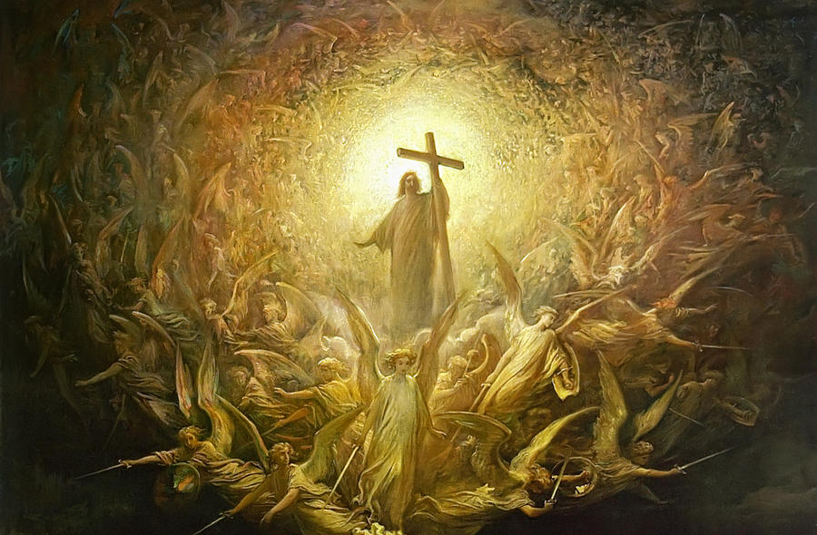
You’ll get a better understanding of Jesus’ Victory.
Notes:
And most of all, you’ll get a better understanding of victory that Jesus won.

Slide 4
Losing to
the
Chess
Master
Notes:
The teaching starts with an example of playing Chess against a Chess Master. (PAUSE)
Imagine your playing against the world Champion, and during the game, the World Champion foolishly loses his Bishop. And you say to yourself, “wow, he made a really stupid move”
Then later, the world Champion foolishly looses his Castle, or Rook. And you say, “Wow, another stupid move”
Then again, the world Champion foolishly looses his Queen, and it looks like he has no hope.
Then, 3 moves later, he Checkmates you.
What would you say about that situation? Well it was a setup, he knew what he was doing, he was just suckering you in. A perfect Setup.

Slide 5
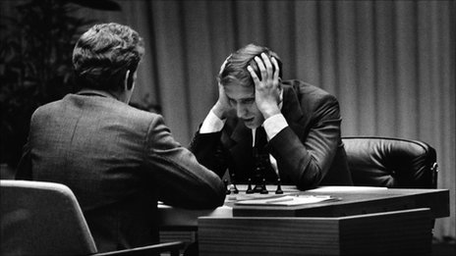
You Got SETUP!
Notes:
The teaching starts with an example of playing Chess against a Chess Master. (PAUSE)
Imagine your playing against the world Champion, and during the game, the World Champion foolishly loses his Bishop. And you say to yourself, “wow, he made a really stupid move”
Then later, the world Champion foolishly looses his Castle, or Rook. And you say, “Wow, another stupid move”
Then again, the world Champion foolishly looses his Queen, and it looks like he has no hope.
Then, 3 moves later, he Checkmates you.
What would you say about that situation? Well it was a setup, he knew what he was doing, he was just suckering you in. A perfect Setup.

Slide 6
Did you ever think of the Cross as a SETUP?
Jesus loses His freedom, reputation, beauty, health, life.
3 Days later, He comes back Victorious.
Notes:
That’s the pattern of a setup.

Slide 7
GOD’s MO
Modus
Operandi
Notes:
Now let’s look at God’s MO. Modus Operandi. How does God Operate?

Slide 8
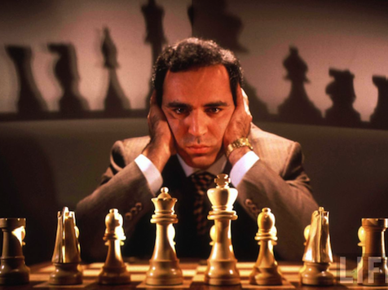
Chess Master
Notes:
To answer this question ask yourself this…What can a Chess Master do that nobody else can?
He can beat you even if he is outnumbered.
He can beat you even if you have much more time on your clock.
He can beat you, while playing 20 other games simultaneously.
He can even beat you blindfolded.
That’s the signature of a Master.

Slide 9
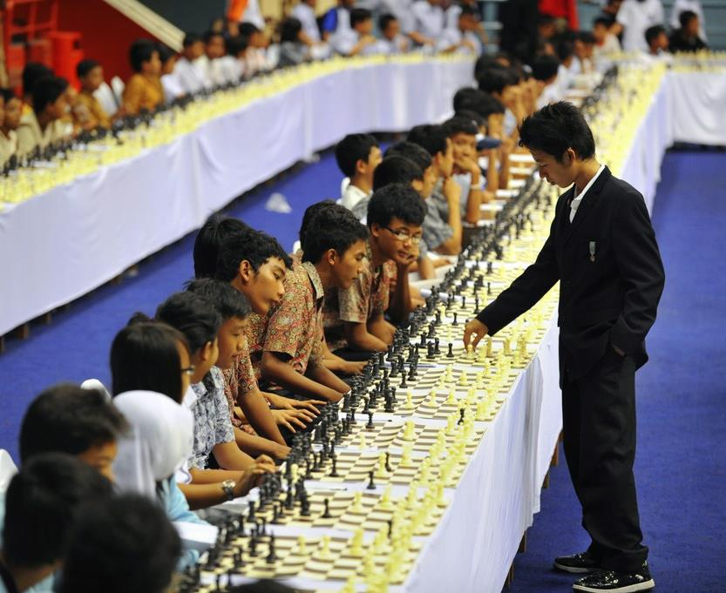
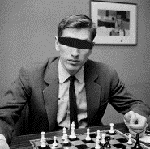
Simultaneous Games
Blindfolded
Notes:
To answer this question ask yourself this…What can a Chess Master do that nobody else can?
He can beat you even if he is outnumbered.
He can beat you even if you have much more time on your clock.
He can beat you, while playing 20 other games simultaneously.
He can even beat you blindfolded.
That’s the signature of a Master.

Slide 10
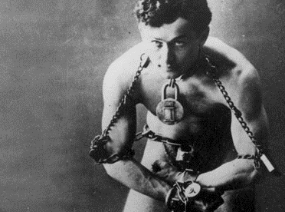
Impossibly
Difficult
Situations
Notes:
They can take impossibly difficult situation, and still win.

Slide 11
We see this same pattern in Scripture.
Notes:
We see this same pattern in Scripture. God takes the most impossible situations, and still wins the victory.

Slide 12
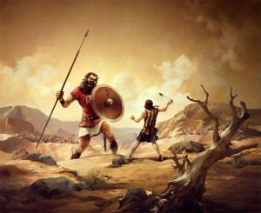
David vs.
Goliath
Stronger?
Larger?
Older?
Experienced?
Weapons?

Slide 13
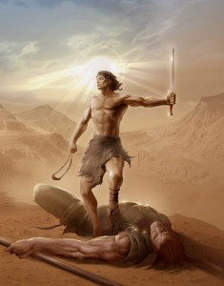
God took every possible disadvantage and still won the fight.

Slide 14
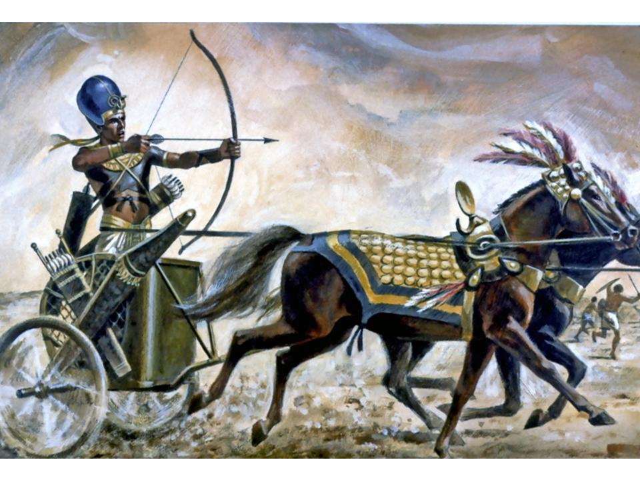
Pharaoh's Army
vs. Israelites
Notes:
In the story of Pharos’s army vs the Israelites.
Who had the weapons? Who had the Chariots? Who had the Army?
Pharo had every conceivable advantage.

Slide 15
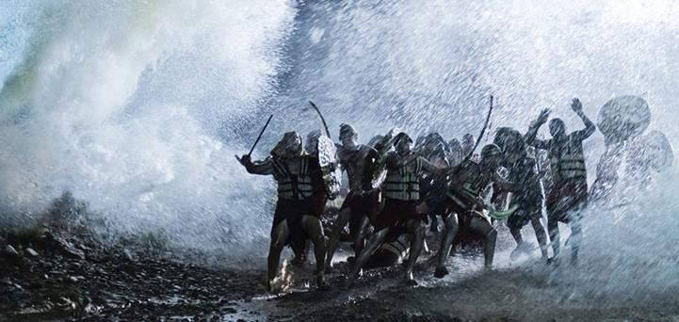
Pharaoh’s Army
All Dead
Notes:
And still God won, and all of Pharos’ army died.

Slide 16
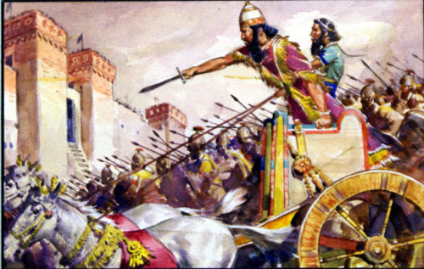
Gideon vs.
Midianites
300 vs. +100,000
Notes:
In the story of Gideos vs. the Midianites. You have 300 Israelites vs. over 100,000 midianite soldiers.
That’s Incredibly bad odds.

Slide 17
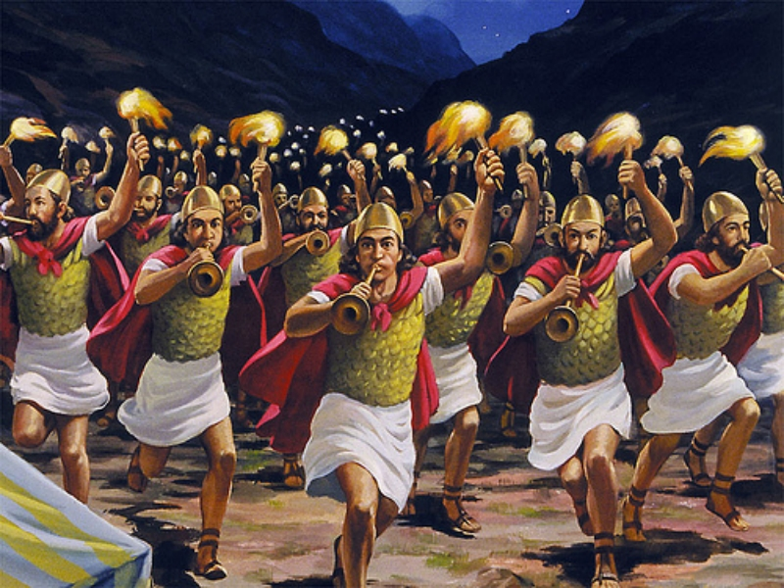
Only 300 men
Notes:
And with everything against them, God still wins the victory.
God loves the impossible situations. Where everything is stacked against Him, and in the last moment, when things look the most bleak, the most hopeless, God turns the tables, and wins a victory.

Slide 18
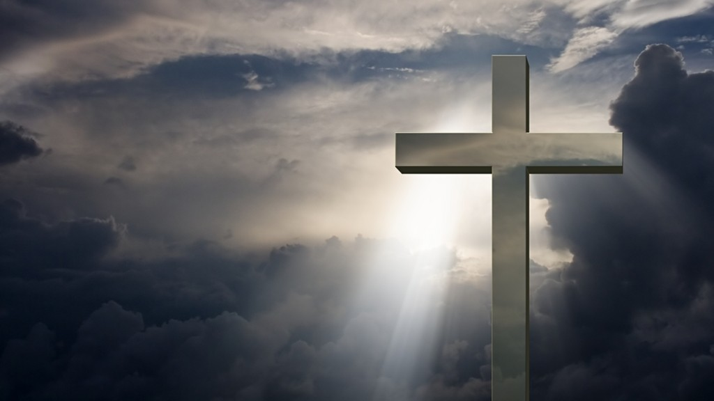
David vs. Goliath
Pharos's Army
vs. Israelites
The
Big
Victory
Gideon vs.
Midianites
Notes:
And these examples are just little battles that point to the Big One. In fact, much of the old testament is pointing to this future Glorious victory at the Cross.

Slide 19
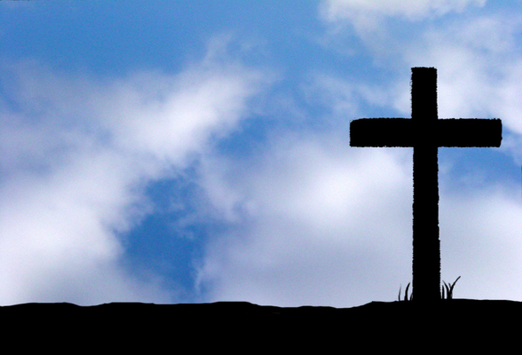
At the Cross
The War of Good vs. Evil was Finished.
evil was Conquered.
satan was defeated.
Jesus was Victorious.
Notes:
And anyone who studies the bible knows these things.

Slide 20
At the Cross…
1. Who was beaten & disfigured?
2. Who was stripped?
3. Who was humiliated & mocked?
4. Who was tormented?
5. Who was silenced, tied up, locked up & suffered?
Notes:
Was it Jesus? Well, Yes, it was. But now you’re going to find out that He wasn’t the only one.

Slide 22
What happened in those 3 Days?
How could such a horrible massacre turn into a such a Glorious Victory?
How did Jesus defeat satan?

Slide 23
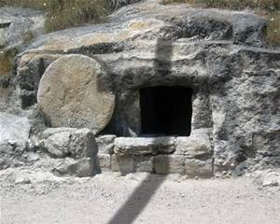
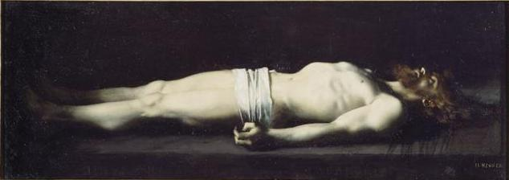
3 Days to Victory!

Slide 24
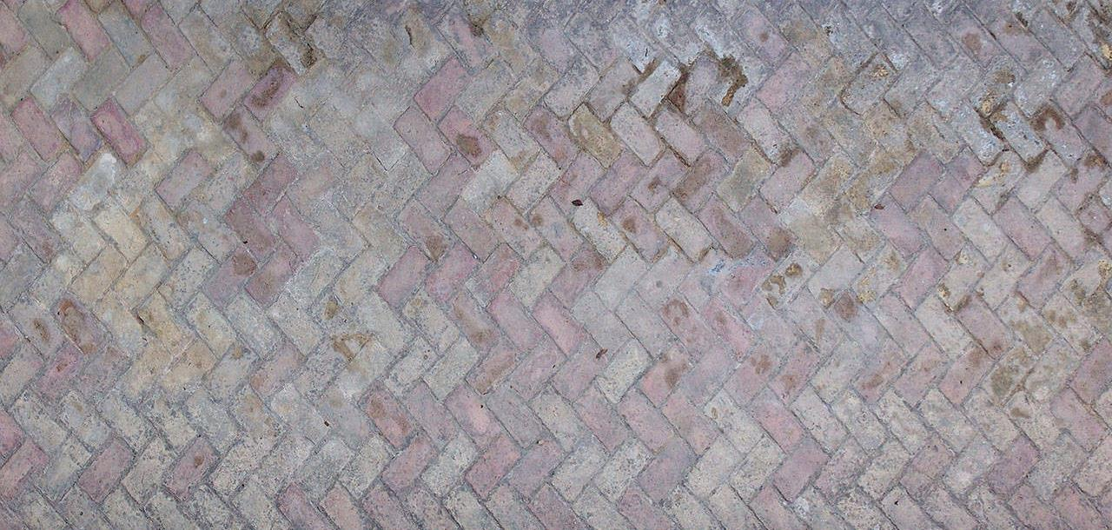
The Cross was
the biggest
Sting Operation
the universe
has ever seen.

Slide 25
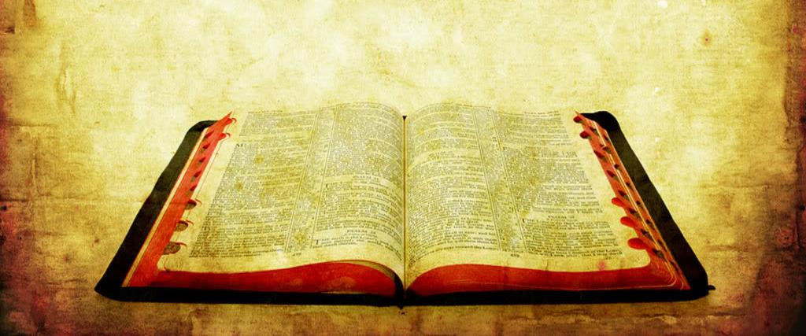
What does the bible tell us about the 3 days?
Ephesians 4:9 “…he also descended
to the lower,
earthly regions”

Slide 26
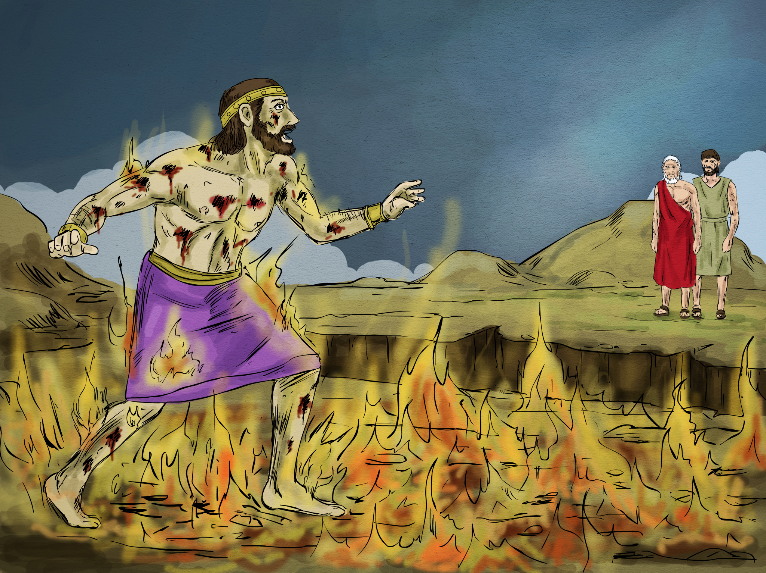
Hades Paradise
Luke 16:19-31
Notes:
From the story of the Rich man and Lazarus, we learn that in the lower earthly regions there was Hades, a place a fire, and paradise, also know as Abraham’s bosom.
And we know that there is some type of Proximity, because the Abraham and the rich man could see and talk to each other.
We also know that there is some kind of Gulf between these 2 places, so that no one could ever cross over.

Slide 27
Colossians 2:15 having disarmed the powers & authorities, he made a public spectacle of them, triumphing over them by the cross.
Notes:
And there’s this wonderful verse in the bible, that summarized what Jesus did during those 3 days.

Slide 28
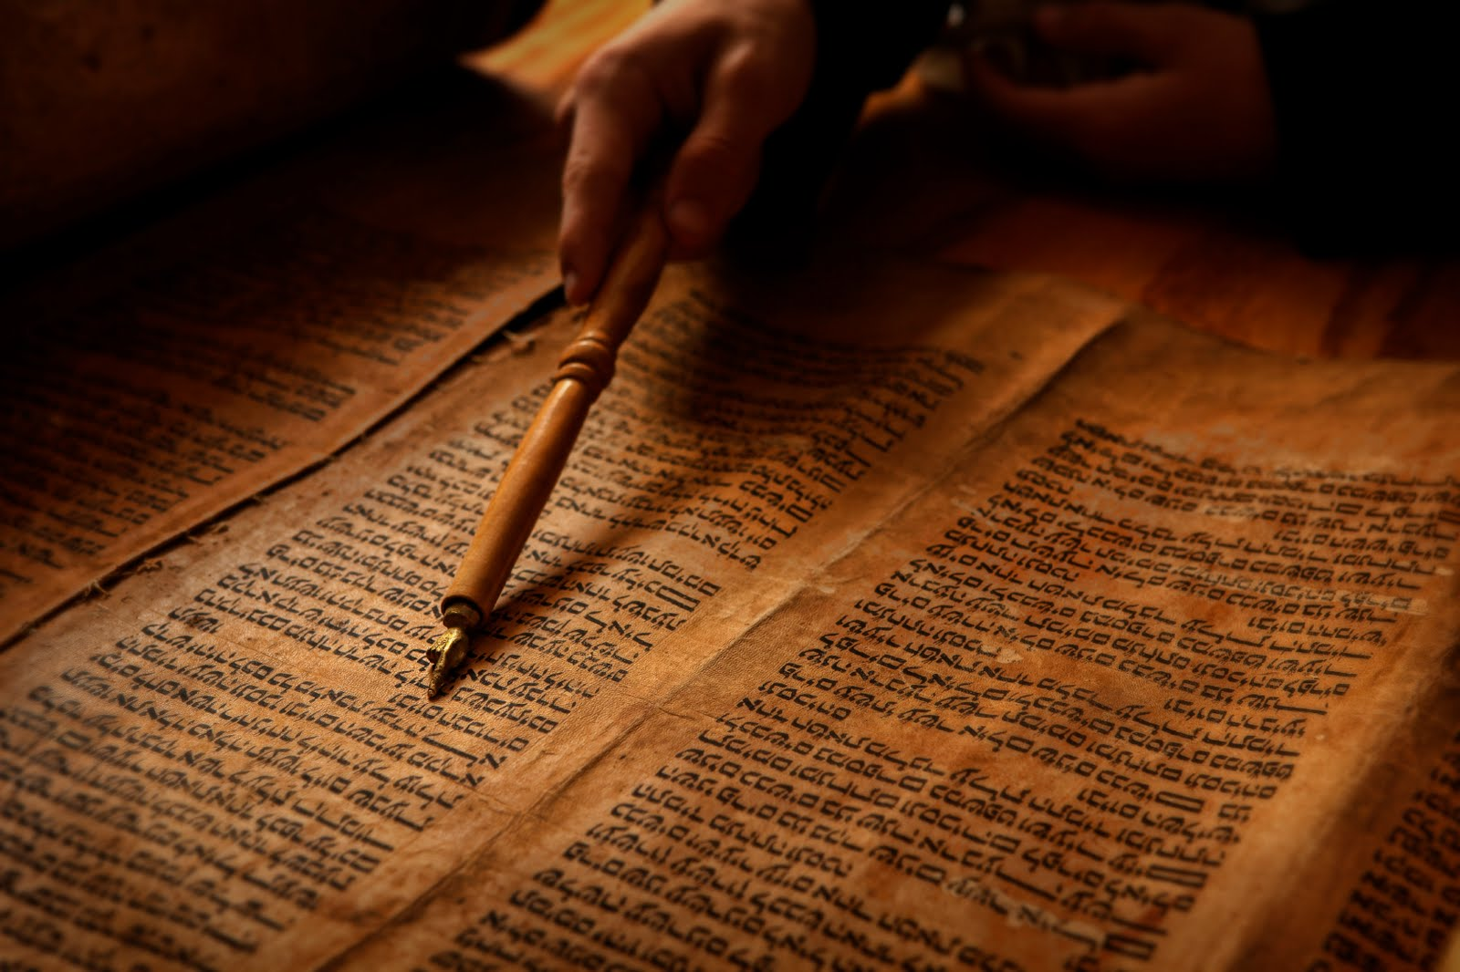
Disarmed Principalities
Took away their power
KJV- “Spoiled Principalities” Defiled their Beauty, of many
Public Spectacle
Embarrassing Defeat, in front of many
Notes:
Let’s break this apart.

Slide 29
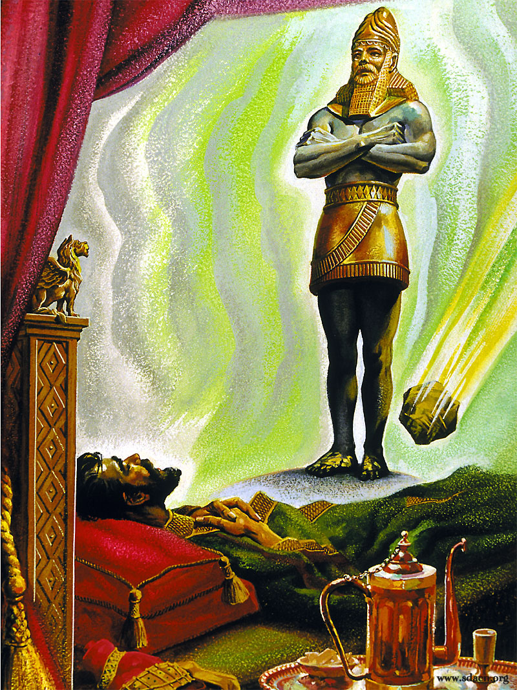
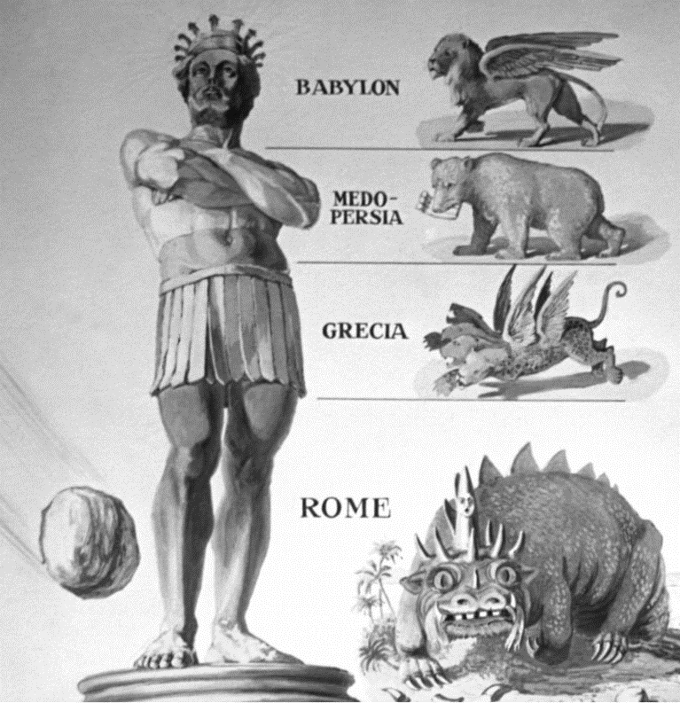
Daniel 2
Notes:
We also get a prophetic glimpse of what Jesus did while in the grave, by Nebuchadnezzar’s dream.
His dream showed a giant statue representing several kingdoms. And a rock, representing Jesus, would come and strike the statue, and instantly destroying it. Not a slow crumbling, but an instant destruction. So we know that when Jesus defeats satans kingdoms, its going to be quick and complete.

Slide 30
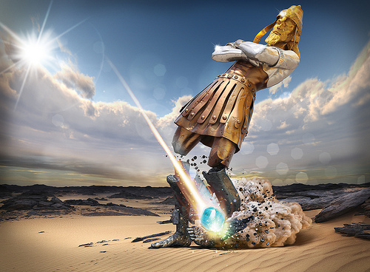
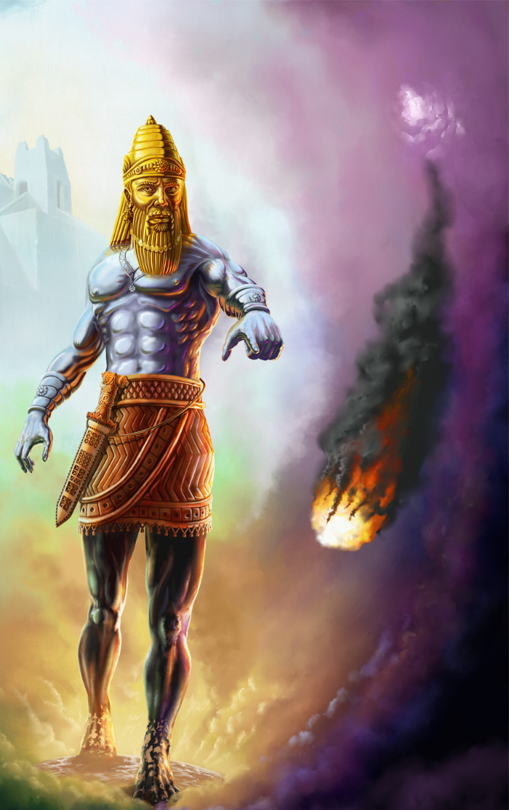
Nebuchadnezzar Dream
Daniel 2
Notes:
We also get a prophetic glimpse of what Jesus did while in the grave, by Nebuchadnezzar’s dream.
His dream showed a giant statue representing several kingdoms. And a rock, representing Jesus, would come and strike the statue, and instantly destroying it. Not a slow crumbling, but an instant destruction. So we know that when Jesus defeats satans kingdoms, its going to be quick and complete.

Slide 31
Revelation
Believe it
or Not
Notes:
Now the rest of the story, the little details of just how Jesus defeated satan while in the lower earthly regions, are given by Revelation.
So you can choose to Believe it or Not. It’s your Choice.
This amazing revelation you’re about to hear is consistent with the pattern of Scripture, and backed up by several verses.

Slide 32
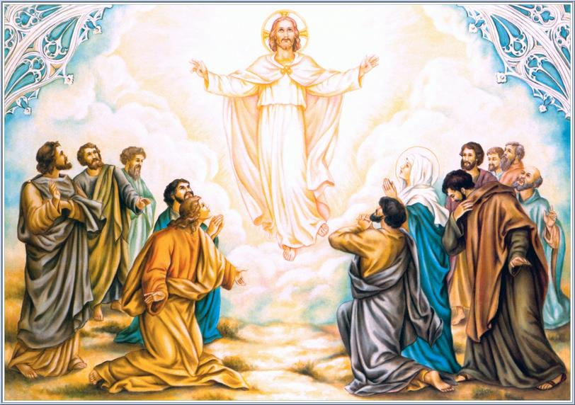
Luke 23:43 ..today you shall be with Me in Paradise."
Jesus appears in Paradise
Notes:
After Jesus dies, he descends down into paradise, or Abraham’s Bosom. Here he is eagerly greeted by all the passed saints. Because of the testimony of John the Baptist who died before Jesus, they were expecting Him. This was the one all the prophets spoke about.

Slide 33
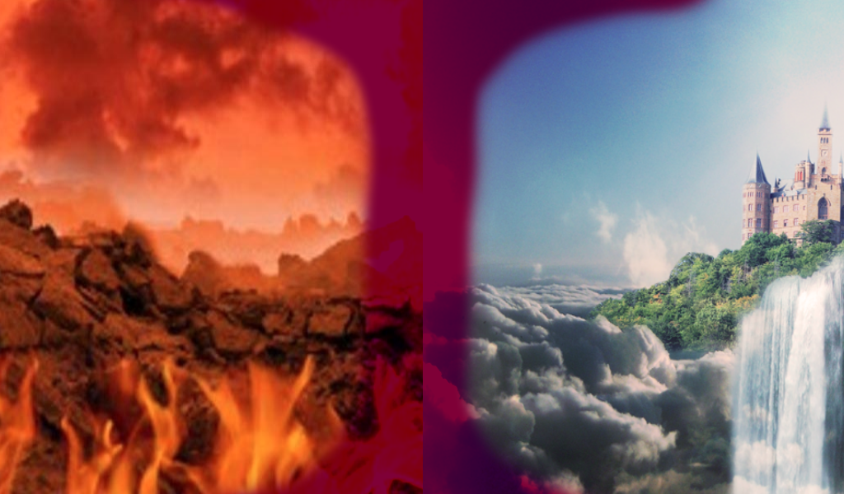
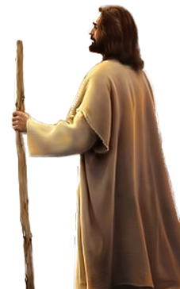
Notes:
Then Jesus does something that no one has ever done before. He crosses over from paradise into Hades.

Slide 34
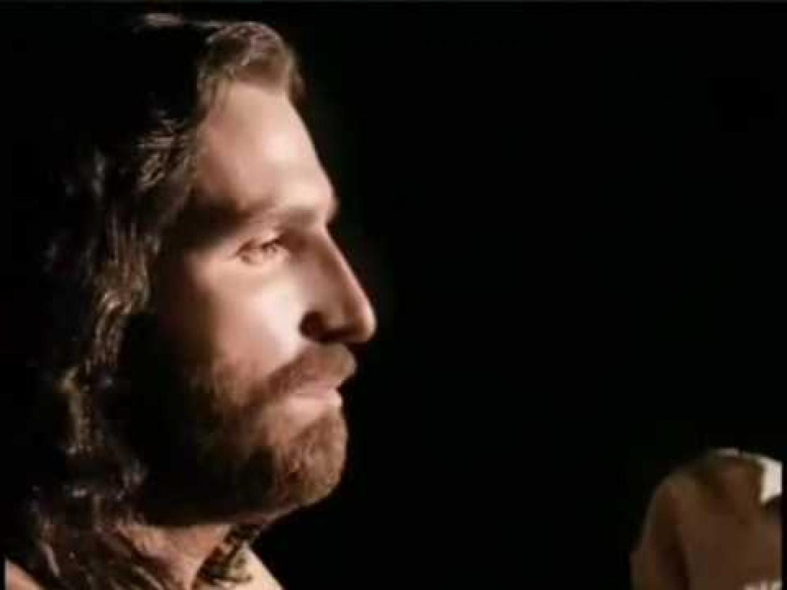
When Jesus shows up
in Hades,
satan’s domain,
He’s not saying or doing anything.
Notes:
When Jesus shows up in Hades, satan’s domain, He’s not saying or doing anything.
No booming voice, no demonstrations of powers, no legion of Angels around him.

Slide 35
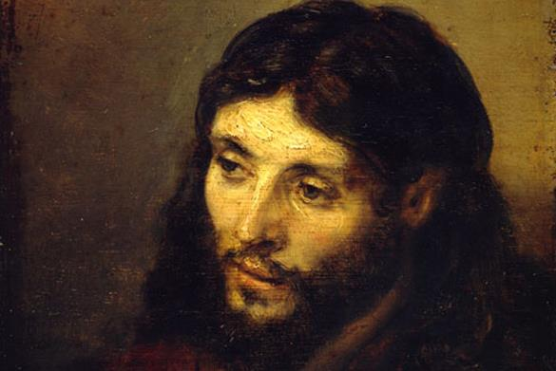
Silent like a lamb.
Just because
Jesus isn’t
saying
anything
doesn’t
mean He has
nothing to say.
Isaiah 53:7
Notes:
He’s just standing there, silent like a lamb.
But remember, just because Jesus isn’t saying anything, doesn’t mean He has nothing to say.

Slide 36
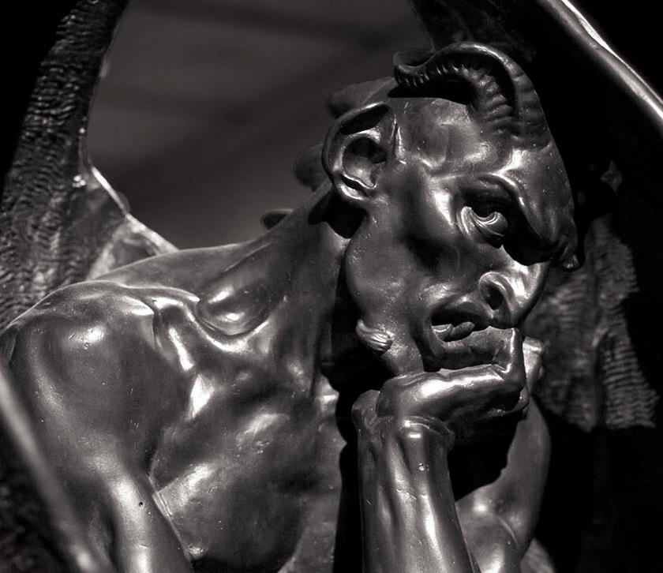
When satan
sees Jesus,
what do you
think was going though his mind?
Notes:
When satan, sees Jesus in Hades, what do you think was going through satan’s mind?
I mean, Jesus is just standing there vunerable, there’s no rescue party, there’s no angel’s protecting Him.
Hades is satan’s domain.

Slide 37
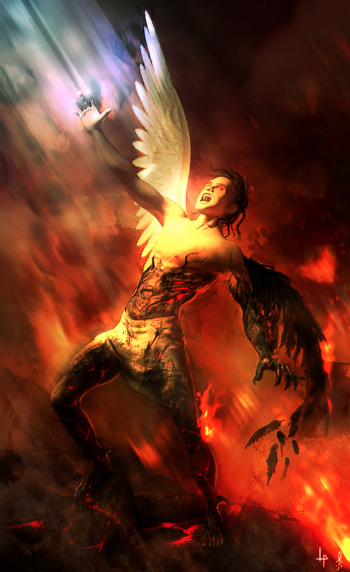
Torment Him!
Strip Him!
Ruin Him!
Publicly
Humiliate
Him!
Still No Rescue Party
Notes:
Being full of pride, satan believes he can anything he wants in Hades and God won’t stop him.
And hating Jesus, satan decides he’s going to ………………. In front of everyone.

Slide 38
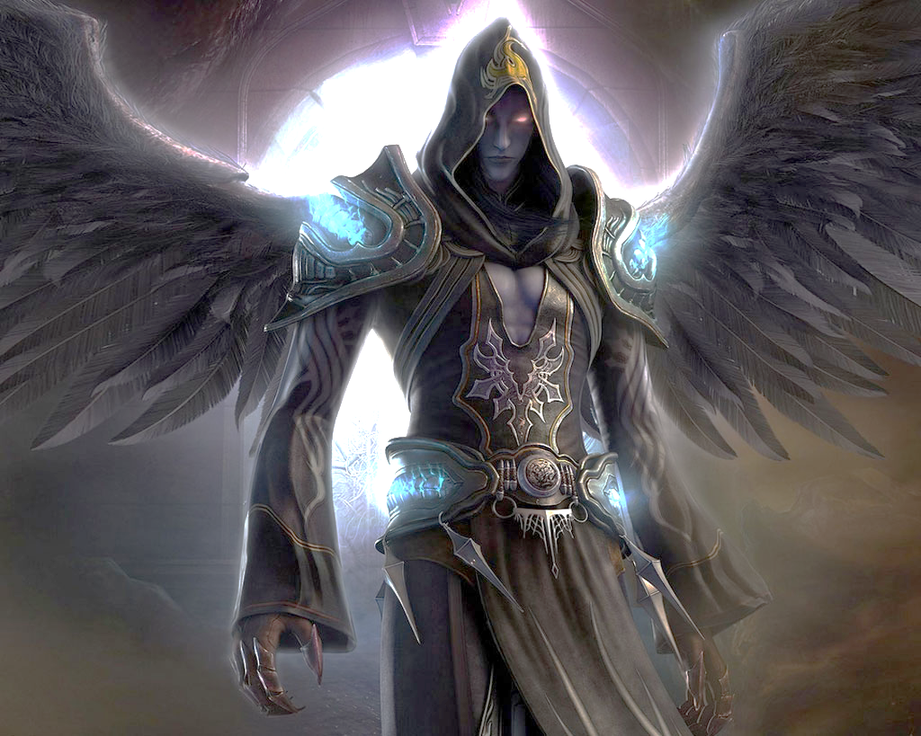
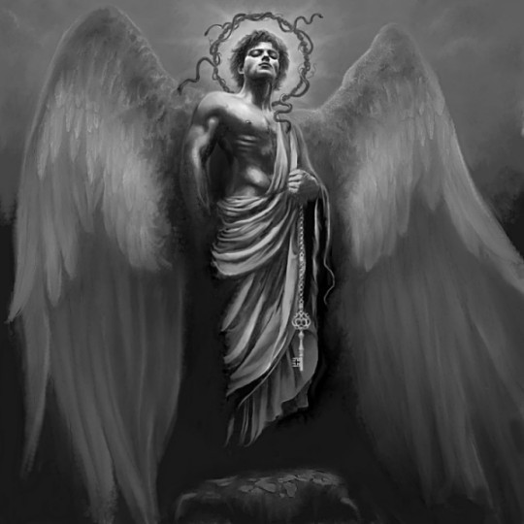
All demons gathered to watch Jesus be tortured.
Notes:
Then satan goes out to gather all his top demons, all the dark principalities and powers, so that they could witness satan destroy Jesus. It took satan about 2 days to gather everyone.

Slide 39
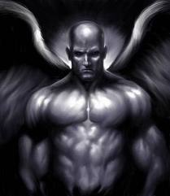
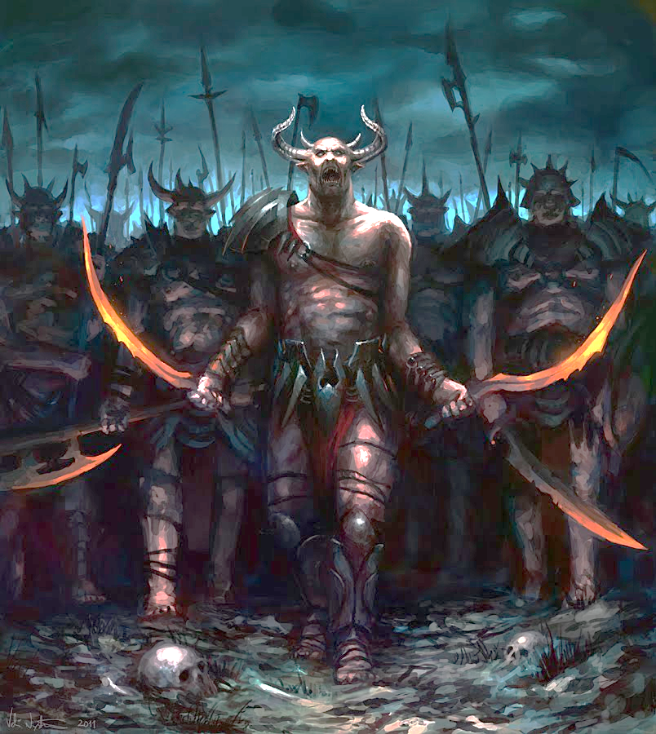
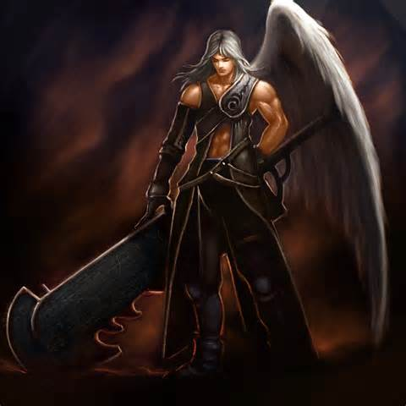
All demons gathered to watch Jesus be tortured.
Notes:
Then satan goes out to gather all his top demons, all the dark principalities and powers, so that they could witness satan destroy Jesus. It took satan about 2 days to gather everyone.

Slide 40
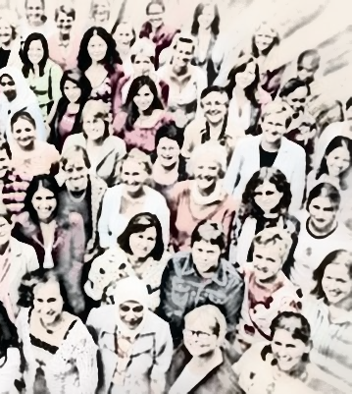
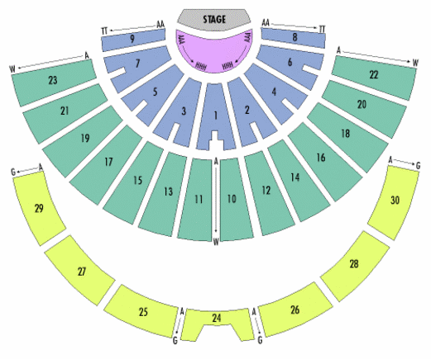
Paradise
Hades
Both sides could watch.
Notes:
satan not only wanted the demons to witness it, he even wanted those in paradise to also watch the destruction of Jesus.
So satan setup the stage on the edge of hades, then the demons could observe from one side, and the saints could see from the other side.
satan didn’t want anyone to miss his glorious victory over Jesus.

Slide 41
Everyone in Paradise Looking Intently
Notes:
All this time, the saints in paradise were looking intently upon the situation. And Jesus was just sitting there, quiet and humble.

Slide 42
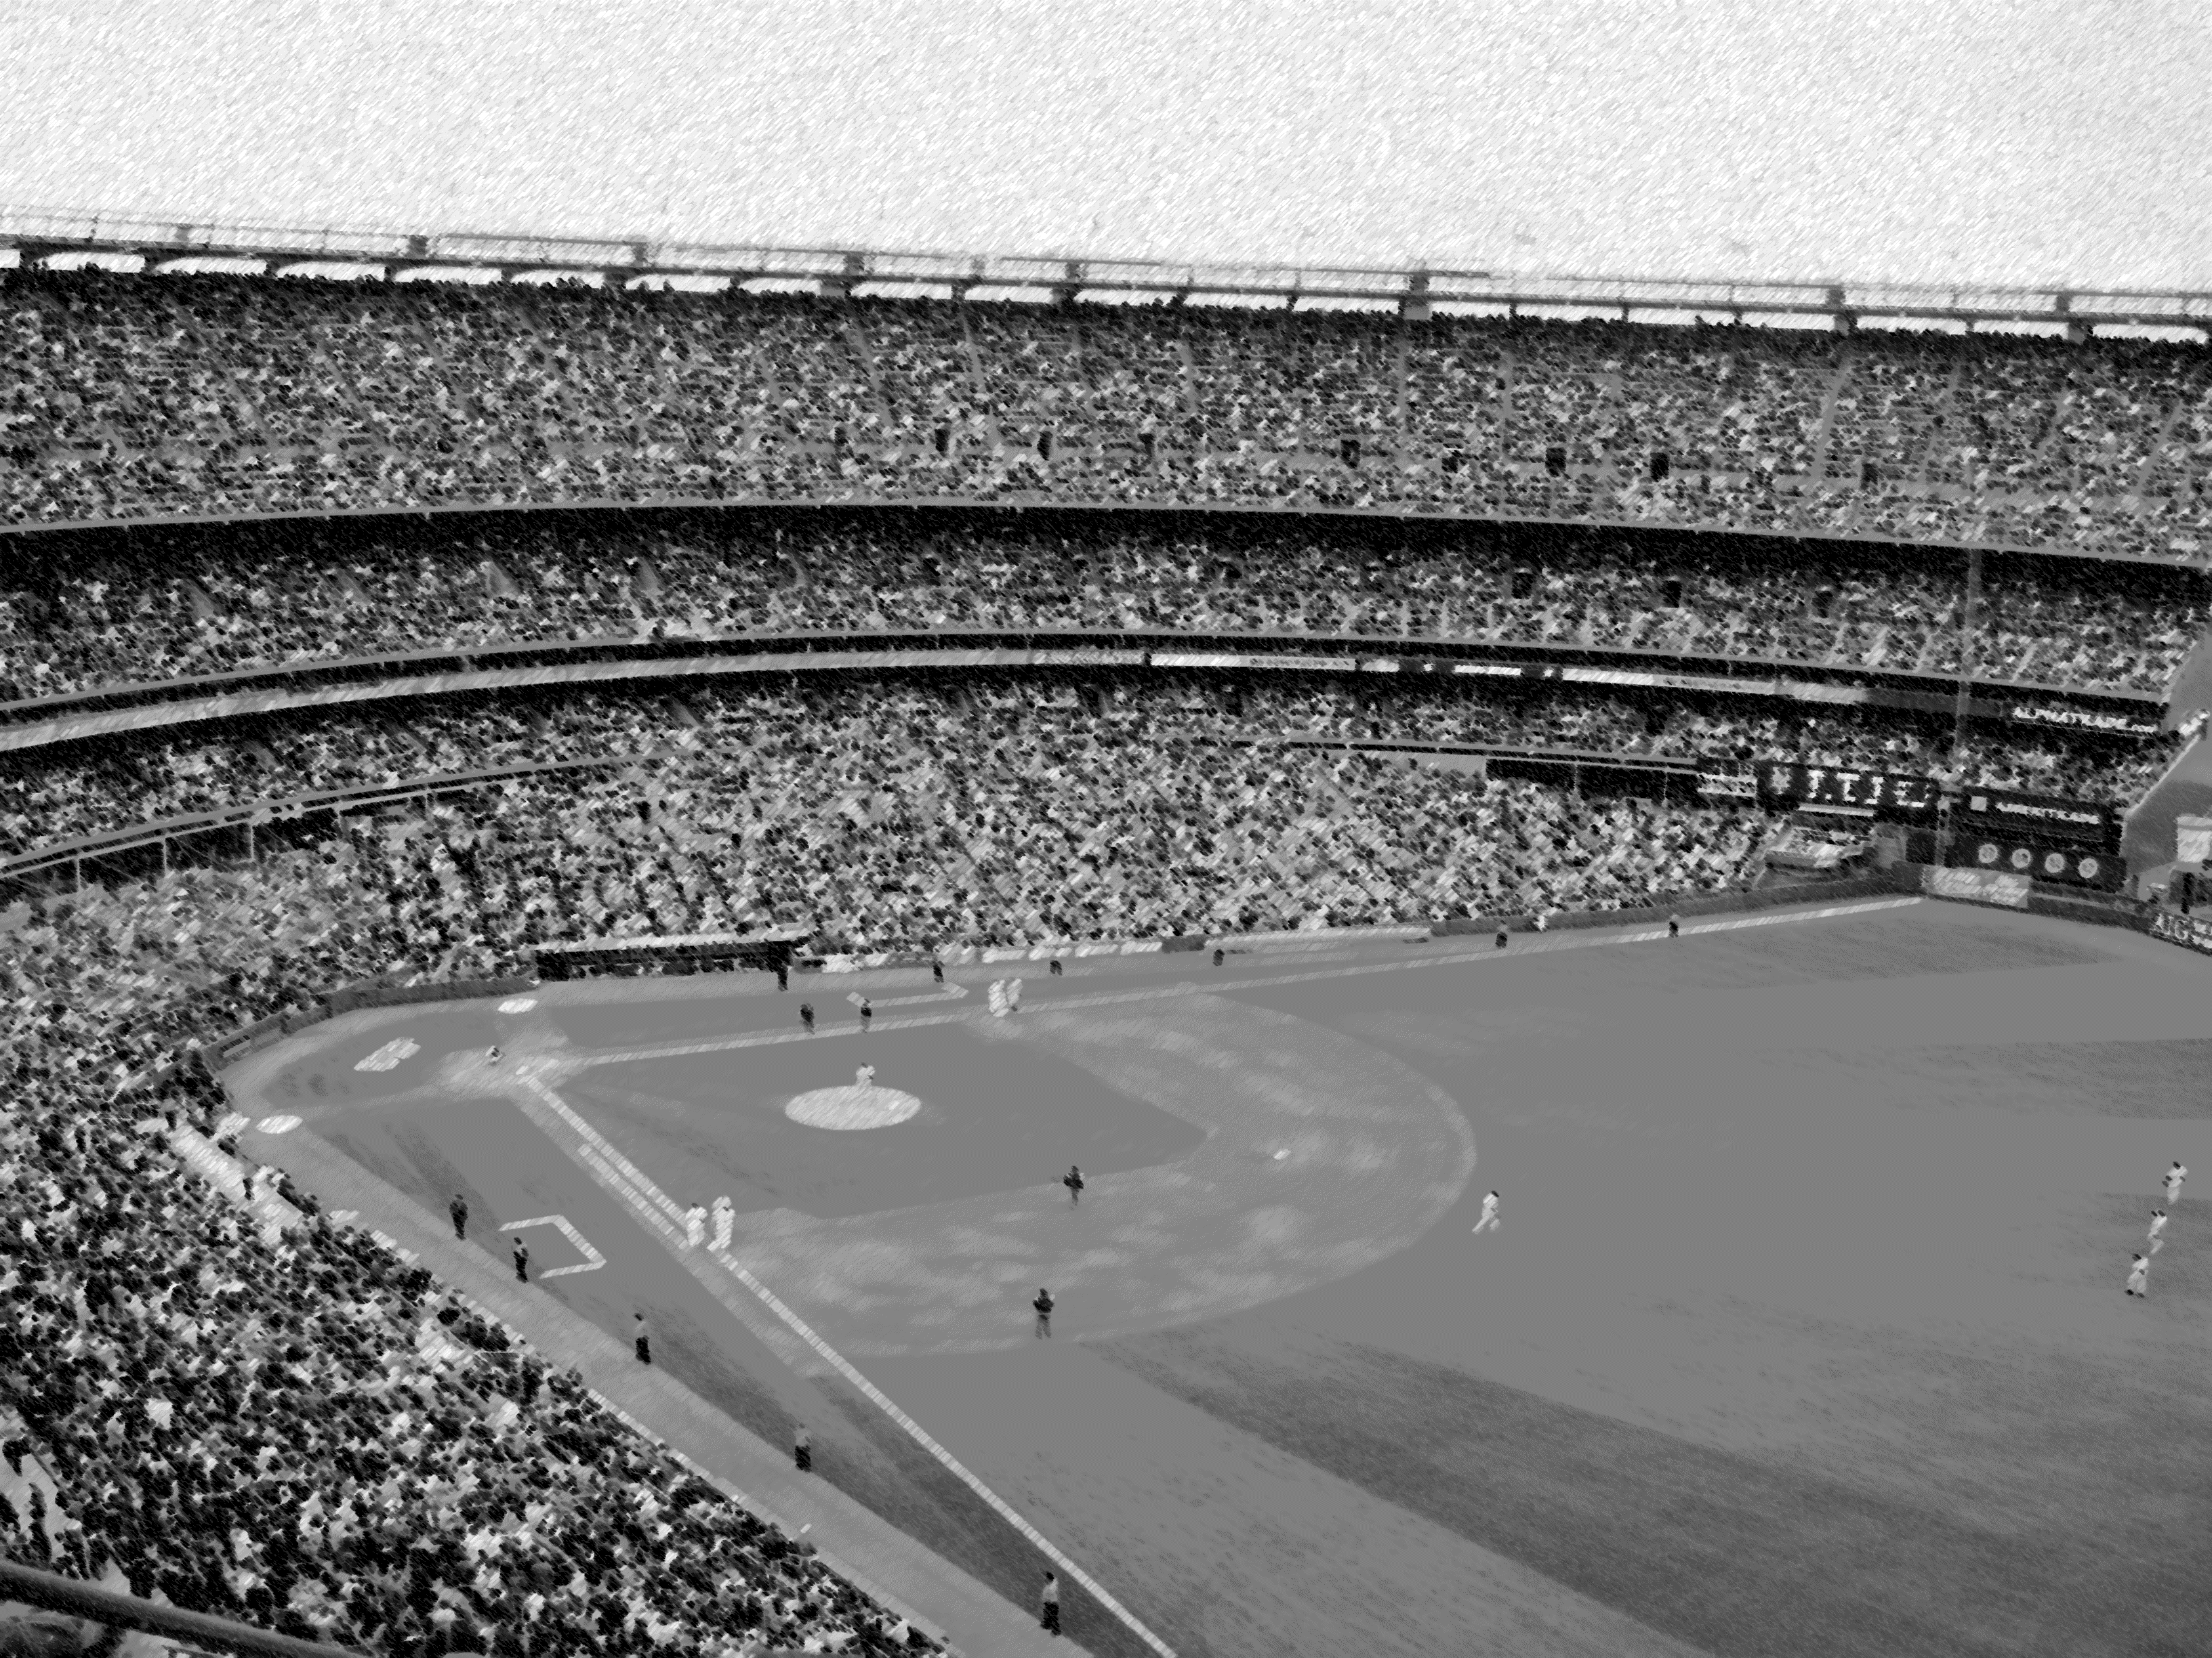
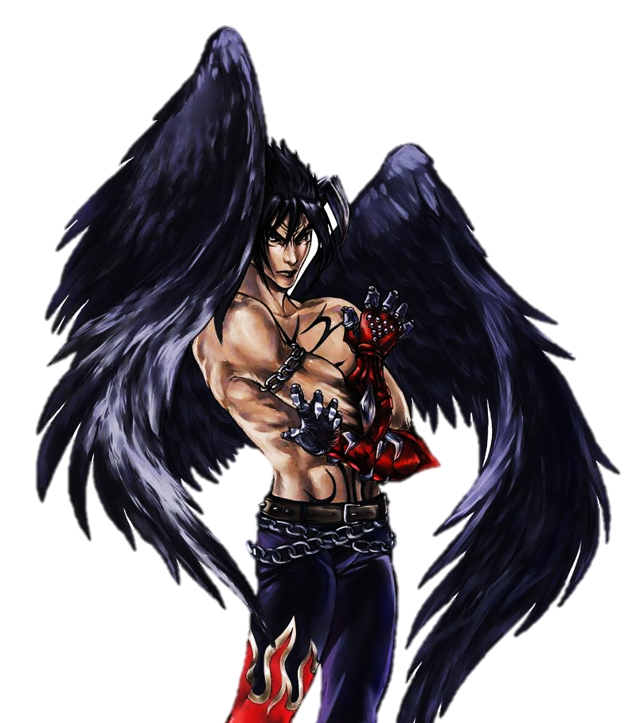
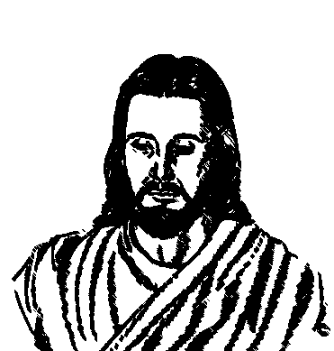
On the 3rd Day
All Top demons are gathered.
Notes:
Then on the 3rd day, satan got dressed up in all his glorious robes, and crowns, and Royal jewels, He looked splendid.
with all the Top Demons watching, satan makes his move to publicly destroy Jesus. Everything look hopeless, You couldn’t imagine a worse situation to be in, Everything was stacked up against Jesus,
But Right before satan grabbed Jesus…

Slide 43
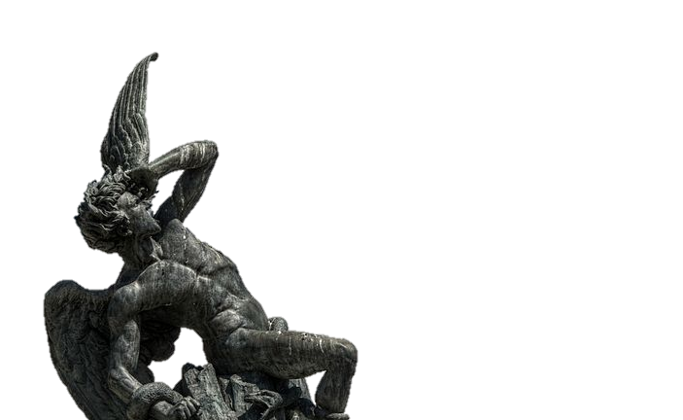
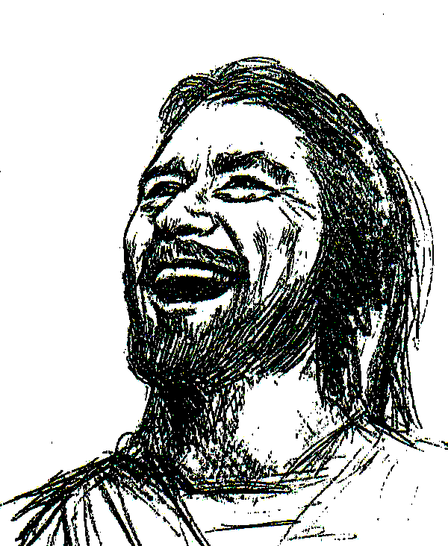
Notes:
The Glory of God blasts in Hell, the whole place up is lit up with God’s glory, and every demon if frozen in place, unable to move.
Then Jesus stands up, ……………7 Secs…………………………………and He’s got the biggest smile on His face you could imagine. He’s been waiting a long time for this moment.

Slide 44
Everyone in Paradise Screaming & Shouting
Notes:
At this time, all the saints in Paradise starts screaming and shouting. They all know what’s coming.

Slide 45
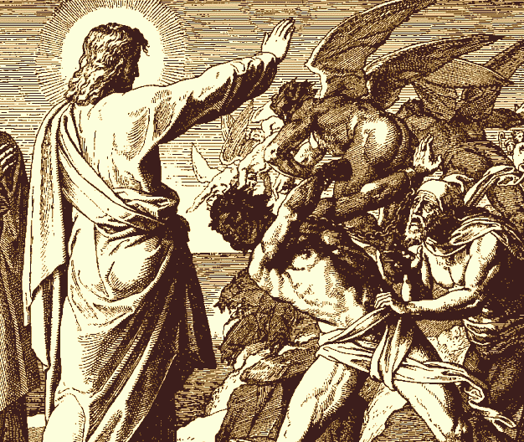
Notes:
Then Jesus goes over to the demons, and thanks to satan, all the demons are assembled and perfectly lined up in rows, Jesus doesn’t have to run after anyone.

Slide 46
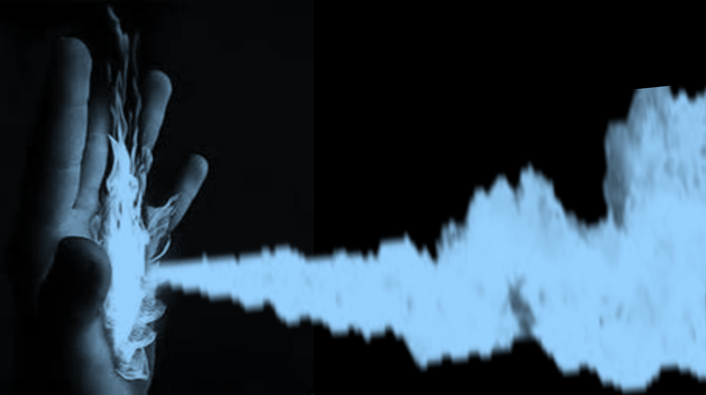
Notes:
Then, according to the revelation, Jesus lifts his hand, and a blue fire shoots out. A fire which is hotter than any fire in Hell.

Slide 47
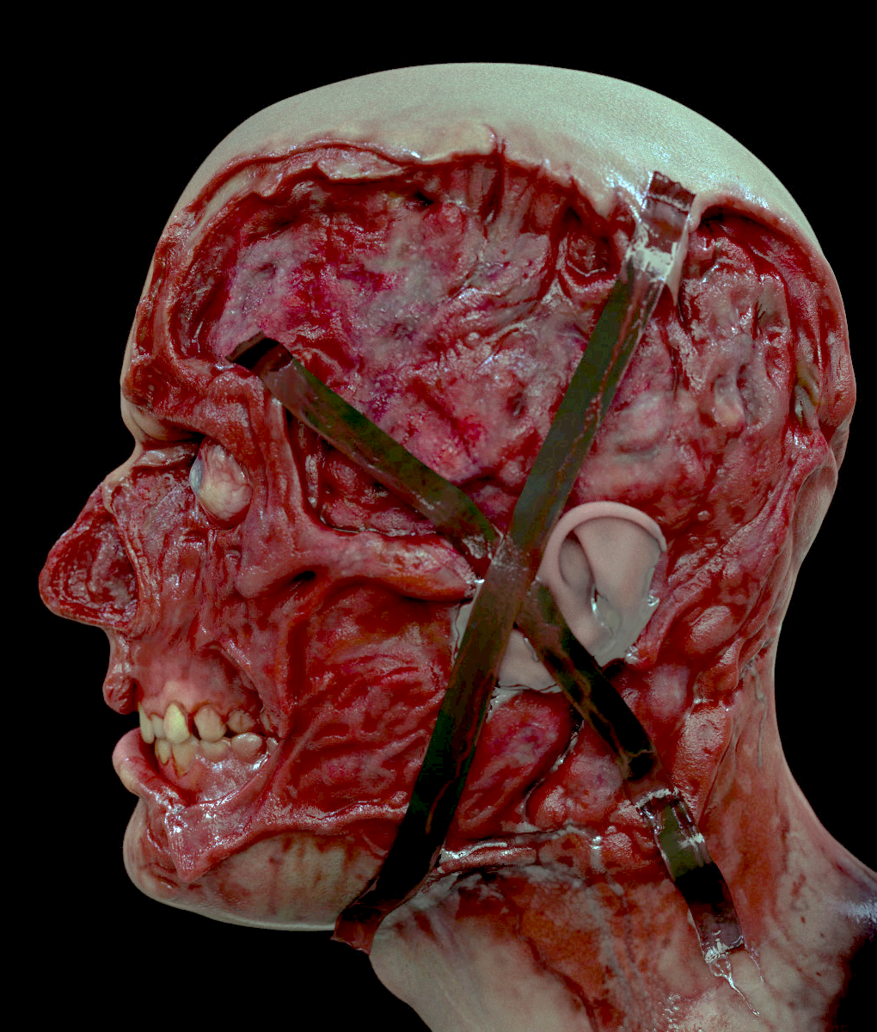
Notes:
And Jesus, systematically burns the faces of all of satan’s top demons. They faces just melt in the intense fire. Their beauty is forever ruined, and they are unable to reverse it.

Slide 48
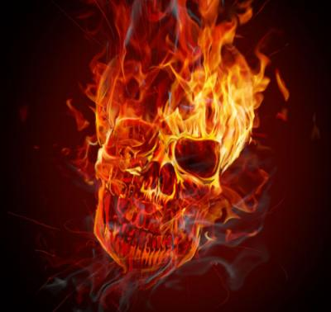
Notes:
And Jesus, systematically burns the faces of all of satan’s top demons. They faces just melt in the intense fire. Their beauty is forever ruined, and they are unable to reverse it.

Slide 49
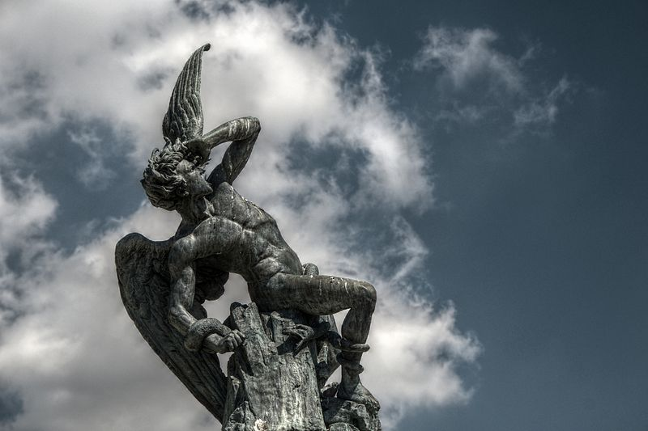
satan
the King
of Terror
now
terrorized
Notes:
Then Jesus goes over to satan, who is normally the King of Terror, but now he’s terrorized in fear. In horror, satan witnessed all his subjects get melted, and now it his turn.

Slide 50
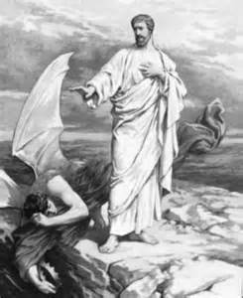
Jesus
strips
satan
of all his
beauty
Notes:
Jesus strips satan of all his beauty, all his robes, all his crowns, all his jewels, and satan is left naked in front of everyone.

Slide 51
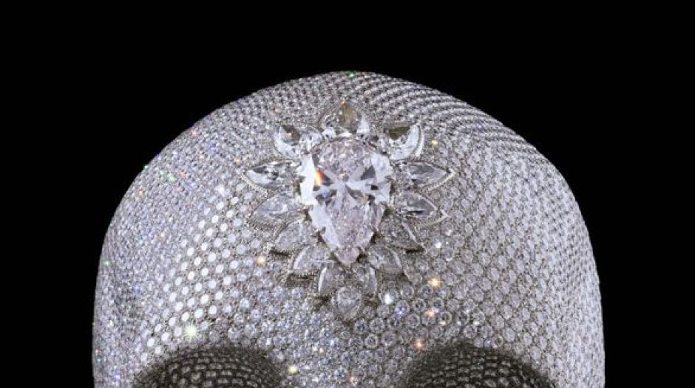
Removes all the Gemstones
Ezekiel 28:12-18
Carnelian, Chrysolite, Emerald, Topaz, Onyx, Jasper, Lapis Lazuli, Turquoise, Beryl
Notes:
In Ezekiel 28, we learn that satans body was beautifully covered in precious jewels. Well Jesus stripped off every last one of them.

Slide 52
Notes:
Now you might have though of Jesus as this gentle person who never fights, and who was beaten up by the Romans, but Jesus can give beating as well as he can take it.
In scripture he is called a warrior.

Slide 53
Exodus 15:3 The LORD is a warrior…
Notes:
Now you might have though of Jesus as this gentle person who never fights, and who was beaten up by the Romans, but Jesus can give beating as well as he can take it.
In scripture he is called a warrior.

Slide 54
satan takes a Heavenly Beating!
Notes:
And on that day, Jesus beat the hell out of satan. On Earth Jesus received a roman beating, But in Hell, Jesus gave satan a heavenly beating.
satan experienced the full force of the Lion of Judah.

Slide 55
Lion of Judah!
Notes:
And on that day, Jesus beat the hell out of satan. On Earth Jesus received a roman beating, But in Hell, Jesus gave satan a heavenly beating.
satan experienced the full force of the Lion of Judah.

Slide 56
Humiliated in front of all his subjects
Ezekiel 28:17 Thine heart was lifted up because of thy beauty, thou hast corrupted thy wisdom by reason of thy brightness: I will cast thee to the ground, I will lay thee before kings, that they may behold thee.
Notes:
satan was humiliated, defeated and thrown down, in front of all his demons and in front of all the saints in paradise.
God, in His wisdom, had satan setup his own defeat.

Slide 57
Rev. 20:2
Notes:
And, as an added insult, God put metallic wrist braces onto satan.
These cuffs had a loop but were not yet bound, as they will be when Rev. 20:2 happens.
And these cuffs, which cannot be removed, will be a constant reminder to satan that some day he will be fully bound.

Slide 58
Rev. 1:18 … and I have the keys of hell and death.
Col 2:15 … Disarmed Principalities…
Jesus takes satan’s power away.
Notes:
Then, after the beating, Jesus took satan’s power away from him, as it tells us in Revelations 1:18 and Col. 2:15

Slide 59
Notes:
After satan’s humiliating beating and defeat, Jesus crosses back over into paradise,
and takes the saints out of there
and up to Earth and then into the Kingdom of God.

Slide 60
Notes:
After satan’s humiliating beating and defeat, Jesus crosses back over into paradise,
and takes the saints out of there
and up to Earth and then into the Kingdom of God.

Slide 61
because of the Cross…
1. Who was beaten & disfigured?
2. Who was stripped?
3. Who was humiliated & mocked?
4. Who was tormented?
5. Who was silenced, bound, & helpless?
Who Really Suffered because of the Cross?
Notes:
Now let me ask you the same questions as I asked before, and see if you have a ‘different’ answer.
… ahh, it was satan and his kingdom….

Slide 62
The Cross was
the biggest
Sting Operation
the universe
has ever seen.
Notes:
Now you see that the ‘Cross’ was the biggest setup, the biggest Sting Operation that the Universe has ever seen.

