Slide 1
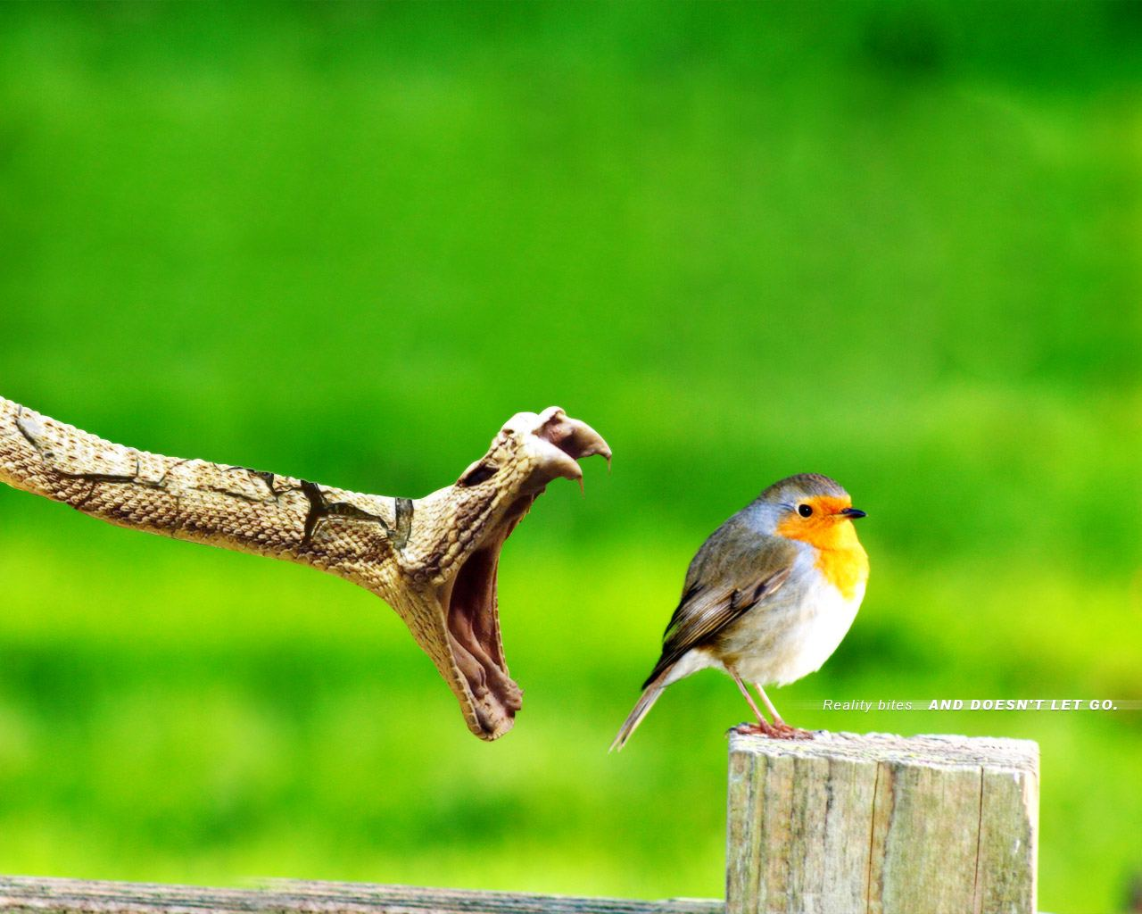
Deadly Mistakes
by the people of God

Slide 2
Some mistakes
are obvious

Slide 4
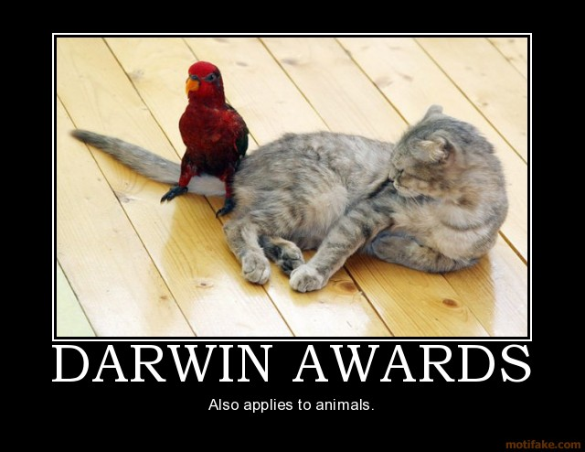

Slide 5
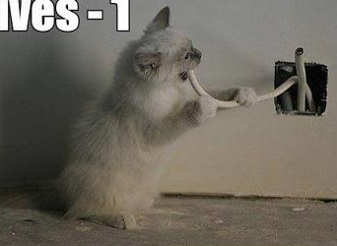

Slide 6
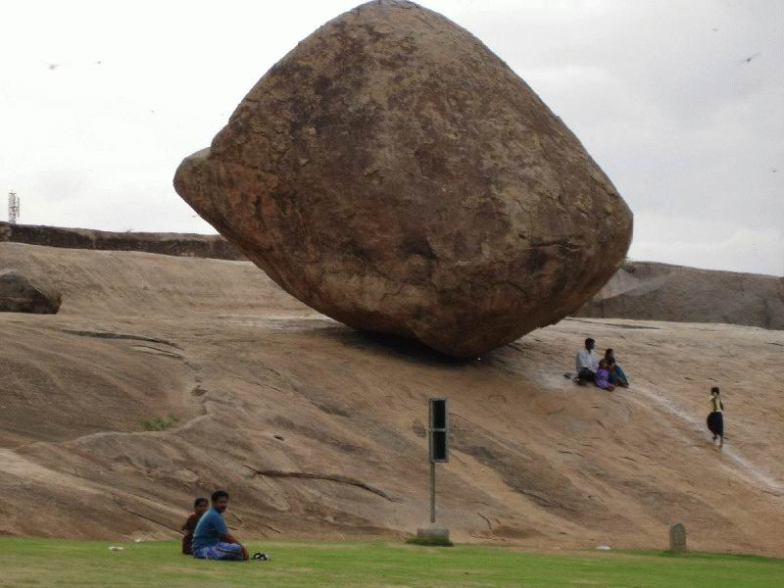

Slide 7
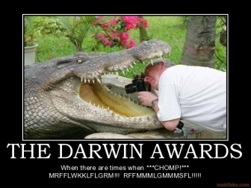

Slide 8
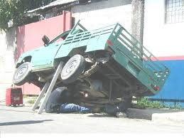

Slide 9
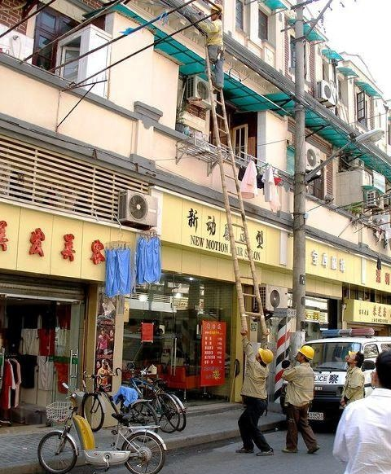

Slide 10
Mistakes from the People
of God
3 Reasons

Slide 11
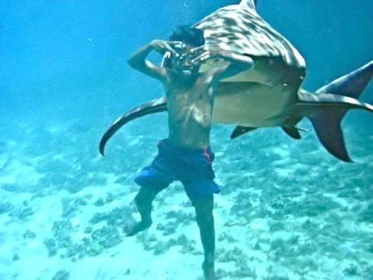
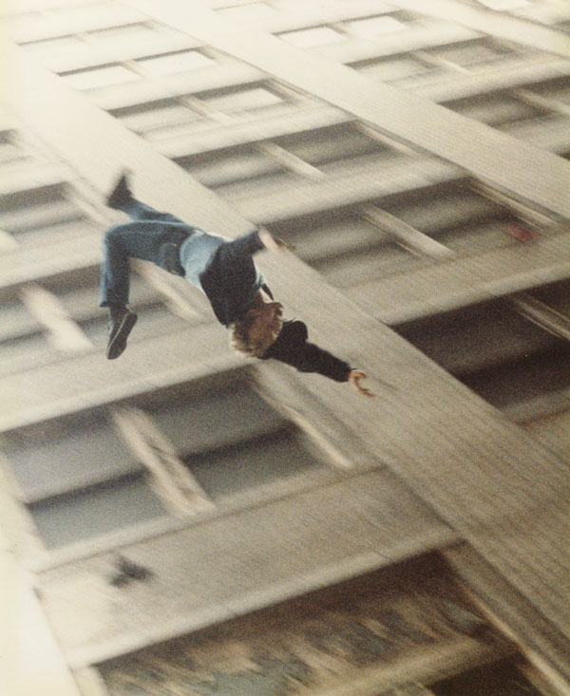
Reason #1
Don’t FEAR the Lord

Slide 12
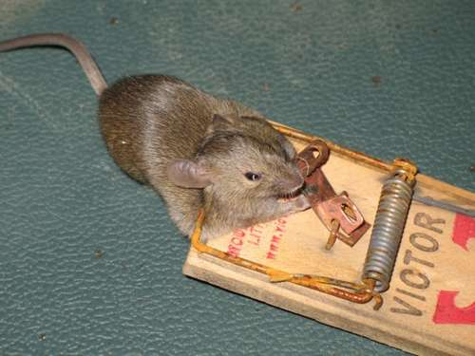
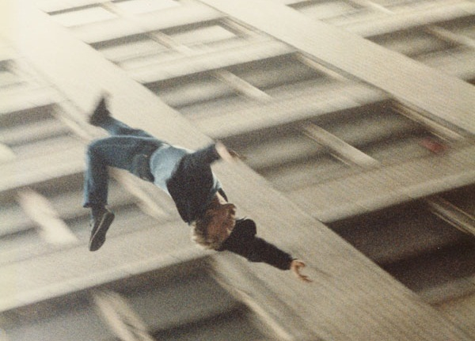
Reason #2
Don’t
REVERENCE
the Lord

Slide 13
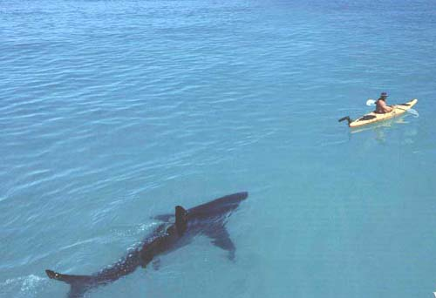
Reason #3
Don’t LISTEN to the Lord

Slide 15
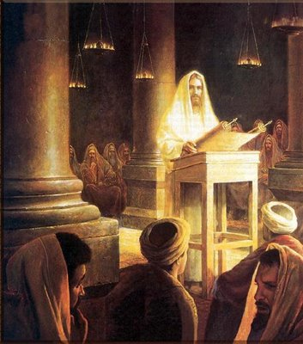

Slide 16
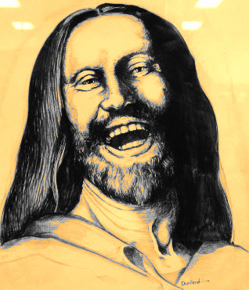
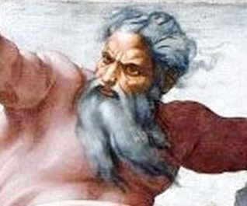
Fun and Loveable Jesus
has replaced Angry Father

Slide 17
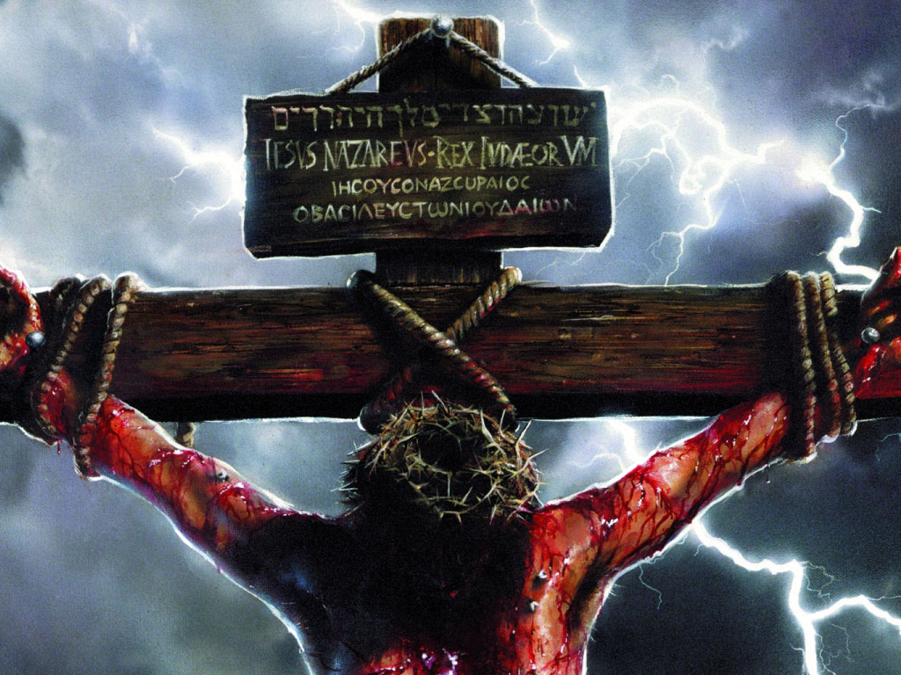

Slide 18
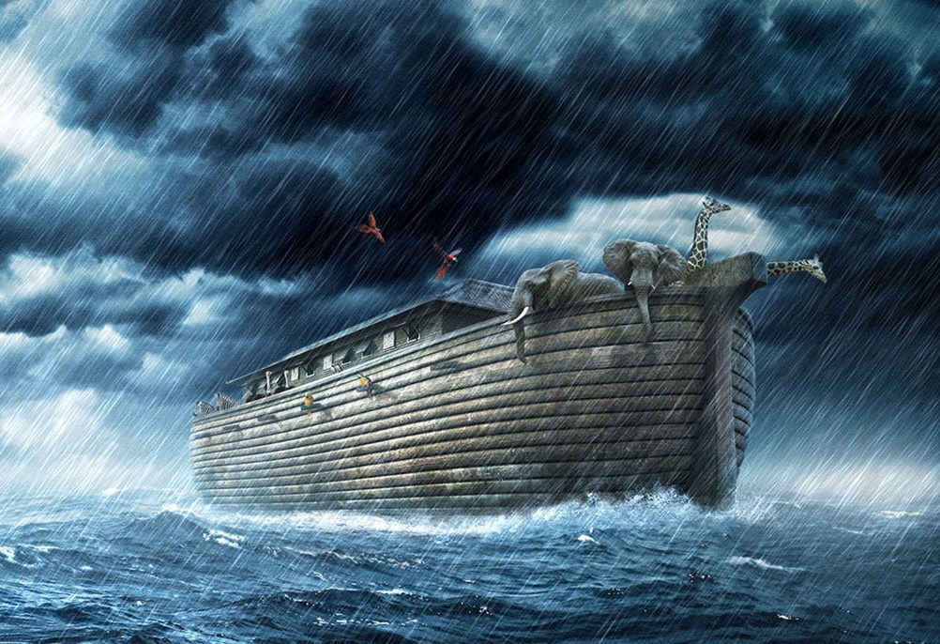

Slide 19
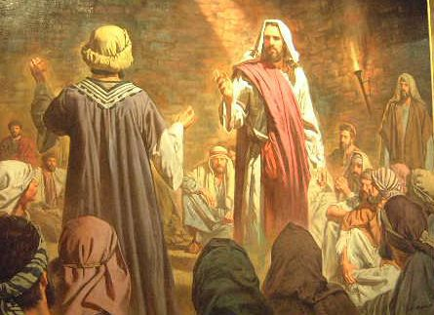
The God of the New Testament is the same God of the Old Testament

Slide 20
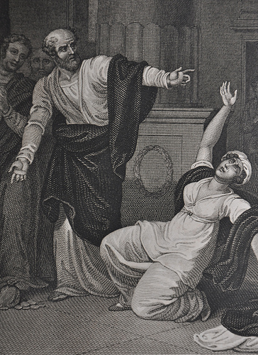
The Fear of the Lord!
Now a man named Ananias, together with his wife Sapphira, also sold a piece of property. With his wife's full knowledge he kept back part of the money for himself,
ACTS 5:1-10
Ananias & Saphira

Slide 21
The Fear of the Lord!
but brought the rest and put it at the apostles' feet. Then Peter said, "Ananias, how is it that satan has so filled your heart that you have lied to the Holy Spirit and have kept for yourself some of the money you received for the land?
ACTS 5:1-10
Ananias & Saphira

Slide 22
The Fear of the Lord!
What made you think of doing such a thing? You have not lied just to man, but to God.” When Ananias heard this, he fell down and died. And great fear seized all who heard what had happened. Then some young men came forward, wrapped up his body, and carried him out and buried him.
ACTS 5:1-10
Ananias & Saphira

Slide 23
The Fear of the Lord!
About three hours later his wife came in, not knowing what had happened. Peter asked her, “Tell me, is this the price you and Ananias got for the land?” “Yes,” she said, “that is the price.”
ACTS 5:1-10
Ananias & Saphira

Slide 24
The Fear of the Lord!
Peter said to her, “How could you conspire to test the Spirit of the Lord? Listen! The feet of the men who buried your husband are at the door, and they will carry you out also.”
ACTS 5:1-10
Ananias & Saphira

Slide 25
The Fear of the Lord!
At that moment she fell down at his feet and died. Then the young men came in and, finding her dead, carried her out and buried her
beside her husband.
ACTS 5:1-10
Ananias & Saphira

Slide 26
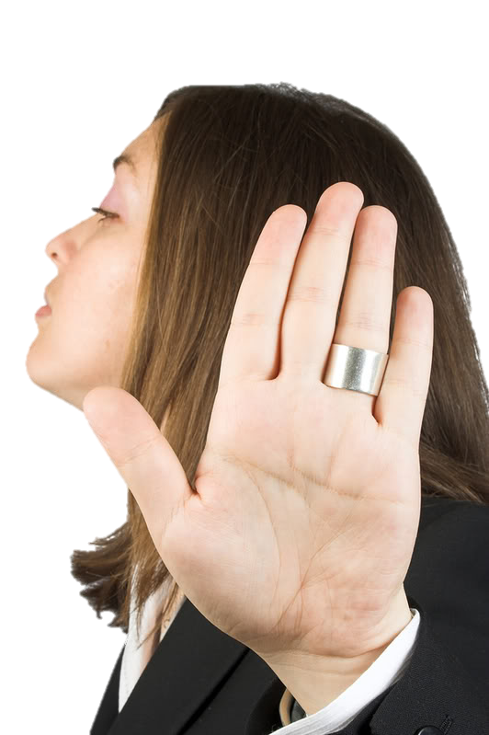
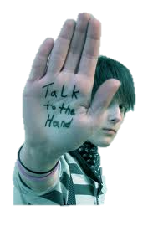
Talk to the Hand
People that won’t listen to God

Slide 27
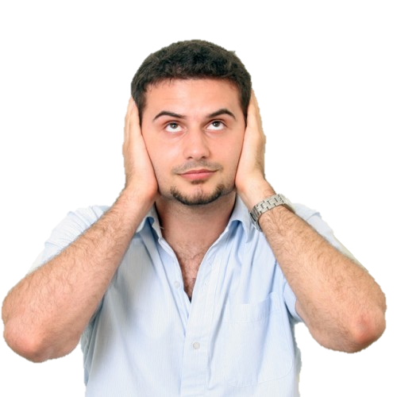
Won’t Listen to God
... a prophet said to his companion, "Strike me with your
weapon," but the man
refused. So the prophet
said, "Because you have
not obeyed the LORD,
as soon as you leave
me a lion will kill
you." And after
the man went
away, a lion
found him and killed him.
1 Kings 20:35-36

Slide 28
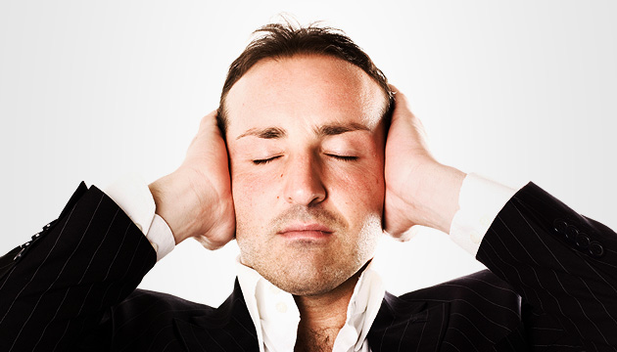
Won’t Listen to God
His advisers and his wife Zeresh said to him,(Haman) "Since Mordecai, before whom your downfall has started, is of Jewish origin, you cannot stand against him--you will
surely come
to ruin!"
Esther 6:13

Slide 29
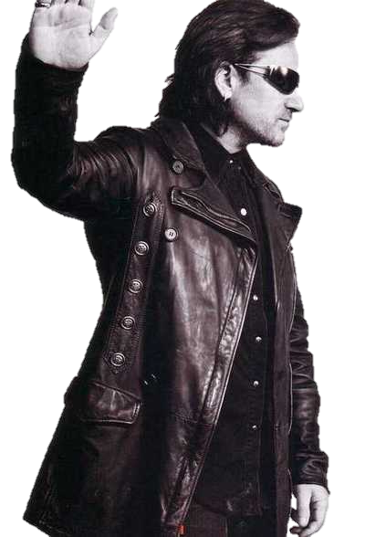
Won’t Listen to God
Then the prophet Hananiah took the yoke off the neck of the prophet Jeremiah and broke it, & said, “This is what the LORD says: ‘In the same way I will break the yoke of Nebuchadnezzar king
of Babylon off the neck of all
the nations within two years.’
...After the prophet Hananiah
had broken the yoke off the neck
of the prophet Jeremiah, the
word of the LORD came to
Jeremiah:
Jeremiah 28

Slide 30
Won’t Listen to God
“Go and tell Hananiah, ‘This is what the LORD says: You have broken a wooden yoke, but in its place you will get a yoke of iron…Then the prophet Jeremiah said to Hananiah the prophet, “Listen, Hananiah! The LORD has
not sent you, yet you have made
this nation to Trust in lies.
Therefore this is what the LORD says:
‘I am about to remove you from the
face of the earth. This very year you
are going to die, because you have
preached rebellion against the LORD.

Slide 31
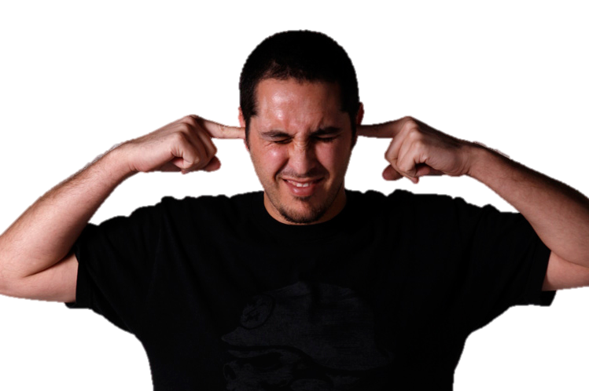
Won’t Listen to God
Because the people did not listen to Jeremiah, the true prophet, they were more likely to believe in the false one, Hananiah,
who told them
what they
wanted to hear.

Slide 32
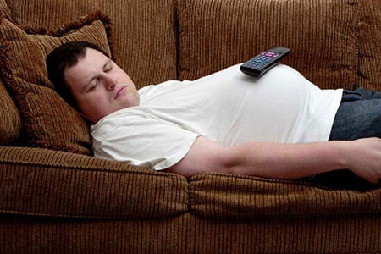
irreverence

Slide 33
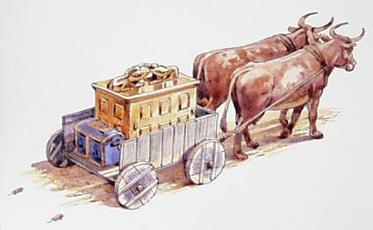
Uzzah
2 Samuel 6:5

Slide 34
David and all Israel were celebrating before the LORD... When they came to the threshing floor of Nakon, Uzzah reached out and took hold of the ark of God, because the oxen stumbled.

Slide 35
The LORD's anger burned against Uzzah because of his irreverent act; therefore God struck him down and he died there beside the ark of God.

Slide 36
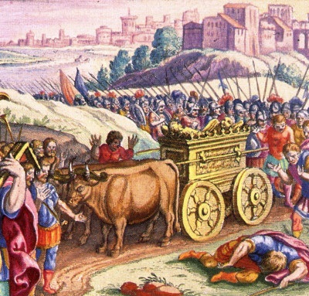
Perez Uzzah

Slide 37
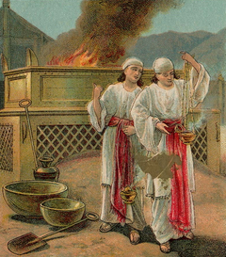
Leviticus 10:1
Nadab & Abihu

Slide 38
Aaron's sons Nadab & Abihu took their censers,
put fire in them
and added
incense;
they offered
unauthorized
fire before
the LORD,
contrary to
His command.

Slide 39
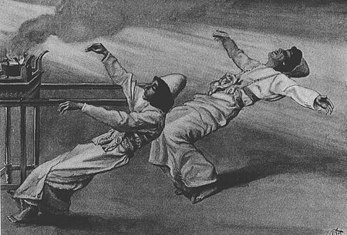
so fire came out from the
presence of the LORD, consumed them, & they died before the LORD.

Slide 40
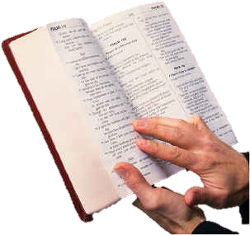
Bible Trivia
What is the Most dangerous sin in the Bible?

Slide 41
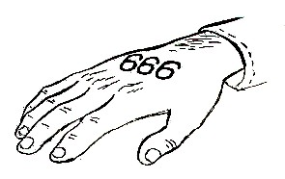
Scripture talks about 2 unforgivable sins.
#1 taking the Mark of the Beast 666
Revelations 14:11
the smoke of their torment ascends forever & ever; they have no rest day or night, who worship the beast and his image, and whoever receives the mark of his name.

Slide 42
Blaspheme the Holy Spirit
Anyone who speaks a word against the Son of Man will be forgiven, but anyone who speaks against the Holy Spirit will not be forgiven, either in this age or in the age to come.
Matthew 12:32

Slide 43
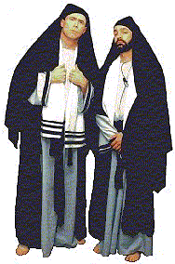
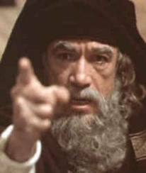
Blaspheme the Holy Spirit
Neglecting, Ignoring & Resisting
the Manifestation of the Holy Spirit

Slide 44
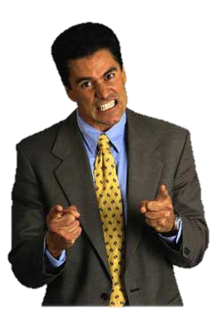
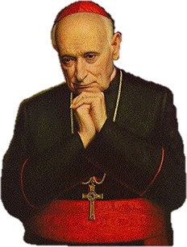
Blaspheme the Holy Spirit
Throughout the ages, Church leaders, pastors & religious authorities have resisted the move of the Holy Spirit in their Churches, because they thought it was evil.

Slide 45
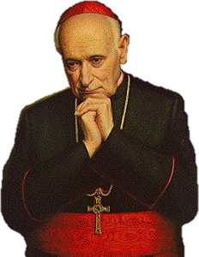
Blaspheme the Holy Spirit
According to one Revelation: The majority of Christians that are in Hell, wound up there because they Blasphemed the Holy Spirit.

Slide 46
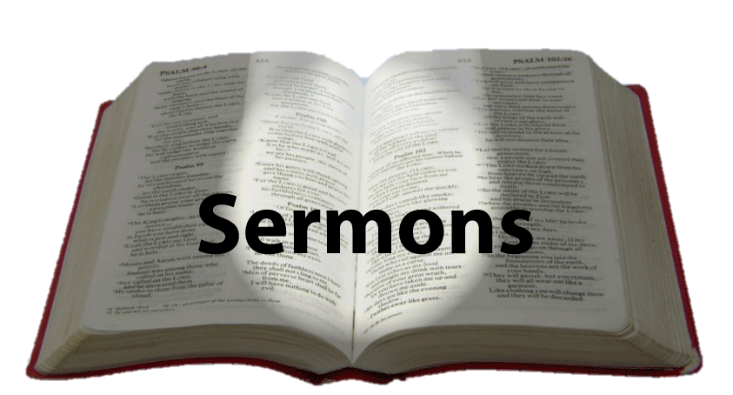
Blaspheme the Holy Spirit
You can search the internet and find many sermons, books and religious teachings claiming that manifestations of the Holy Spirit are fake & demonic.

Slide 47
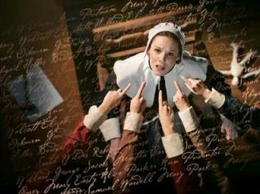
Attacking the
Lord’s Servants

Slide 48
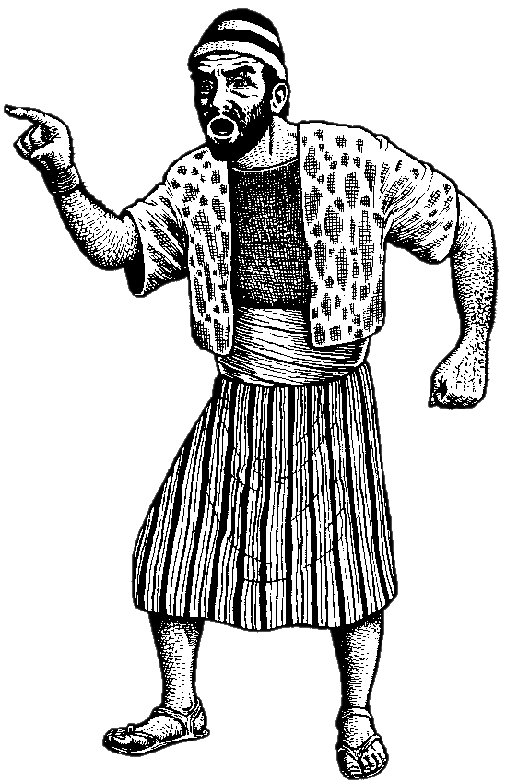
Do not touch my anointed ones; Do my prophets no harm.
--Ps. 105:15
Miriam and Aaron began to talk against Moses because of his Cushite wife, for he had married a Cushite. “Has the LORD spoken only through Moses?" they asked.
"Hasn't he also spoken through us?" And the LORD heard this…At once the LORD said to Moses, Aaron and Miriam, "Come out to the Tent of Meeting, all three of you." So the three of them came out…”
--Numbers 12

Slide 49
Do not touch my anointed ones; Do my prophets no harm.
--Ps. 105:15
Listen to my words: When there is a prophet among you, I, the LORD, reveal myself to them in visions,
I speak to them in dreams. But this is not true of my servant Moses; he is faithful in all my house. With him
I speak face to face, clearly and not in riddles; he sees the form of the LORD
--Numbers 12

Slide 50
Do not touch my anointed ones; Do my prophets no harm.
--Ps. 105:15
Why then were you not afraid to speak
against my servant Moses? The anger of the LORD burned against them,
& He left them.
--Numbers 12

Slide 51
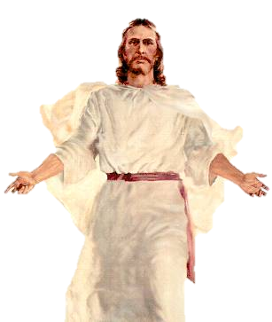
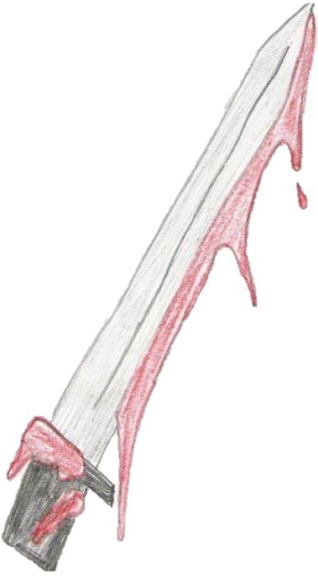
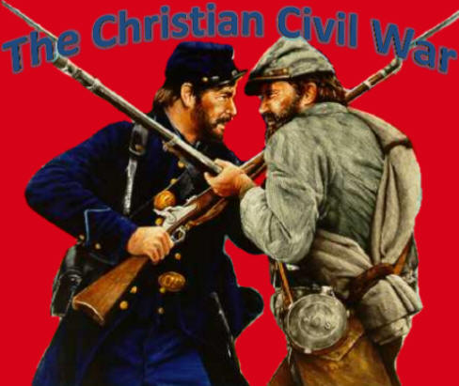
A Vision – Philip Elston
In this vision, Philip saw the Lord standing with His arms outstretched. Soldiers in blue and gray uniforms were marching past Him and were laying their bloody swords on
His arms. The Lord resolutely
looked into the eyes of
each one, saying, "No one who has
their brother's blood on
their sword will be used
to build My house."

Slide 52
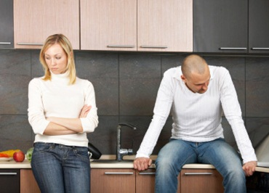
Unforgiveness

Slide 53
if you do not forgive men their sins, your Father will not forgive your sins.
Matthew 6:15

Slide 54
Observe My Sabbaths & have reverence for My sanctuary. I am the LORD. .
Leviticus 26:2

Slide 55
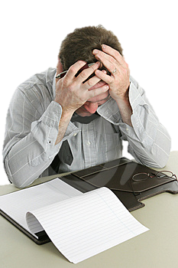
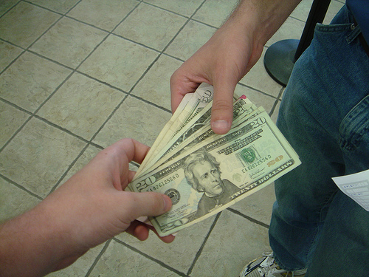
Keeping the Lord’s day Holy

Slide 56
My house will be called a house of prayer for all nations…
Mark 11:17

Slide 57
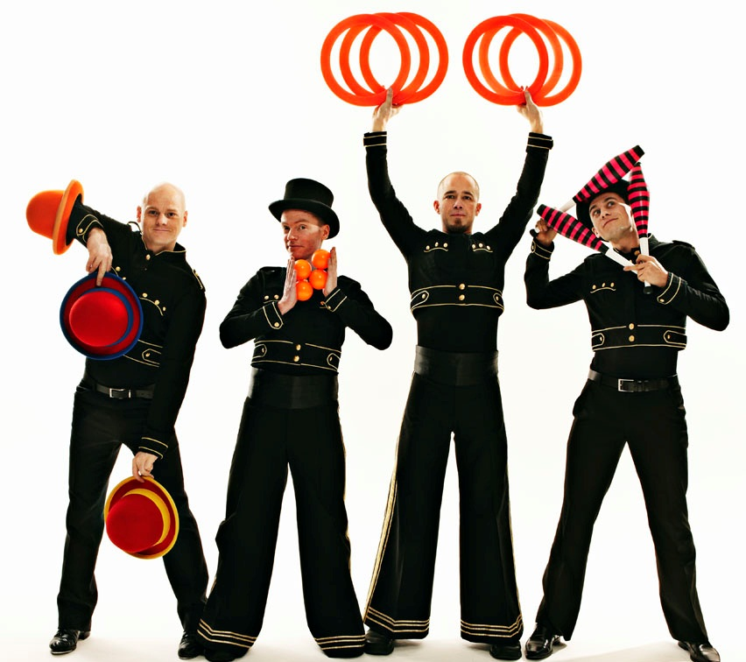
The House of Entertainment

Slide 58
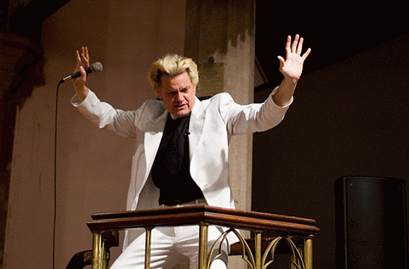
The House of Show

Slide 59
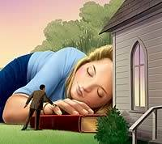
Prayerless Christians

Slide 60
Worldly & Lukewarm

Slide 61
You are the salt of the earth. But if the salt loses its saltiness, how can it be made salty again? It is no longer good for anything, except to be thrown out and trampled underfoot.
-Matthew 5:13

Slide 62
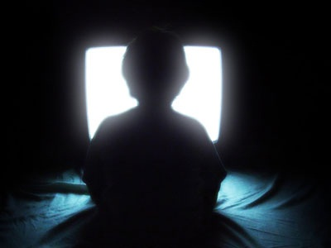
Worldly & Lukewarm

Slide 63
Worldly & Lukewarm

Slide 64
Worldly & Lukewarm

Slide 65
Return of Christ

Slide 66
Luke 17:34

Slide 67
on that night two people will be in one bed; one will be taken & the other left. Two women will be grinding grain together; one will be taken, the other left.
Luke 17:34

Slide 68
Matthew 25
Foolish Virgins

Slide 70
Unprepared for the End Times

Slide 71
Too Late!

Slide 74
Bible Trivia
In the New Testament account, who was most eager to
have their family saved?

Slide 75
The Rich Man
Luke 16:19

Slide 76
Hold the Fire and Brimstone
June 19, 2002
The Mention of Hell from Pulpits is at an all-time low.

Slide 77
Luke 10:2
The Harvest is plentiful, but the laborers are few.
Evangelism

Slide 78
Deadly Mistakes
by the people of God

Slide 79
Reason #1
Don’t FEAR the Lord

Slide 80
Reason #2
Don’t
REVERENCE
the Lord

Slide 81
Reason #3
Don’t LISTEN to the Lord

Slide 82
Avoiding Deadly Mistakes

