Slide 1
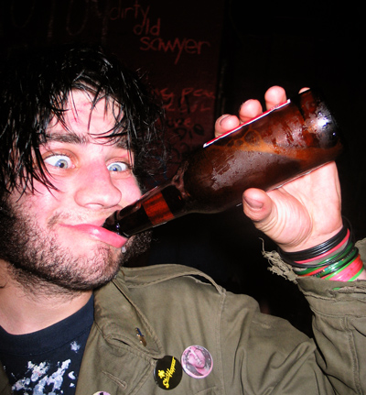
Read or Not!
You are Drunk ☹

Slide 2
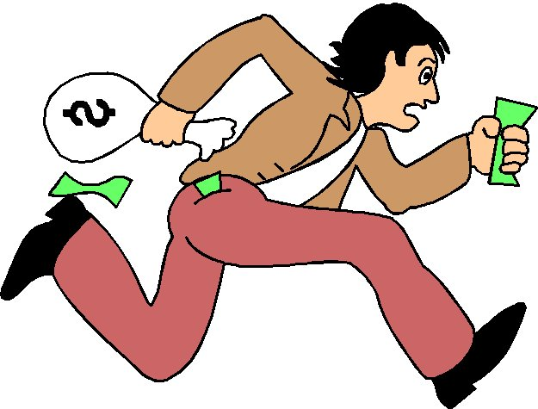
Read or Not!
You are STEALING ☹

Slide 3
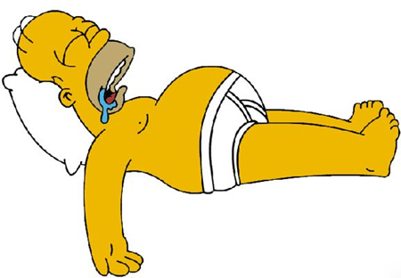
Read or Not!
You are Sleeping ☹

Slide 4
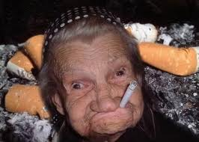
Read or Not!
You are SMOKING ☹

Slide 5
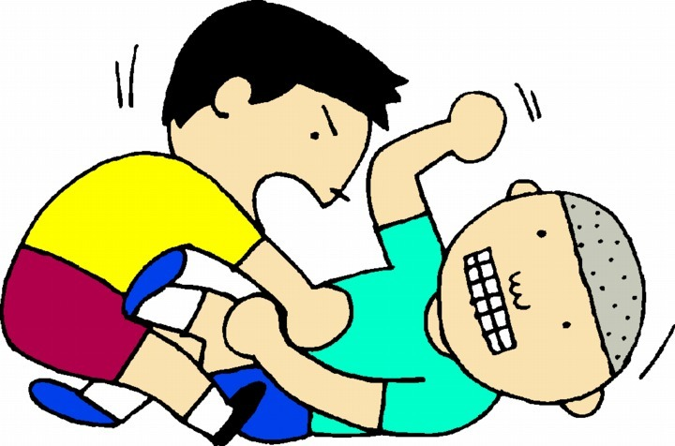
Read or Not!
You are FIGHTING ☹

Slide 6

Read or Not!
You are Armed & Ready ☺

Slide 7
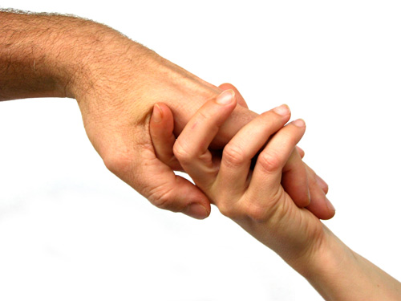
Read or Not!
You are Helping Others☺

Slide 8
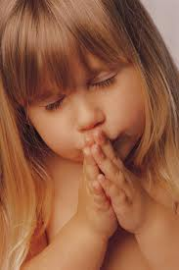
Read or Not!
You are Praying ☺

Slide 9

Read or Not!
You are Watching ☺

Slide 10
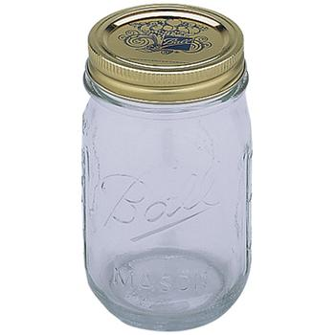
Read or Not!
You Jar is Empty ☹

